Slide 1
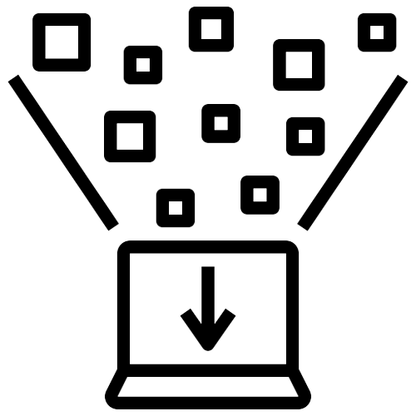

TEAM MEMBERS:
BIG DATA PROJECT
Under supervised of:
Dr/ Tayseer Hassan Abd-Elhamid
Doaa Sayed Ibrahim
Ahmed Mohsen Mohamed
Ahmed Khaled Noor El-Hady
Merihan Youssef Abd-Elnasser
Toqa Abdel-Sattar Mohamed
Aya Omar Mosa

Slide 2


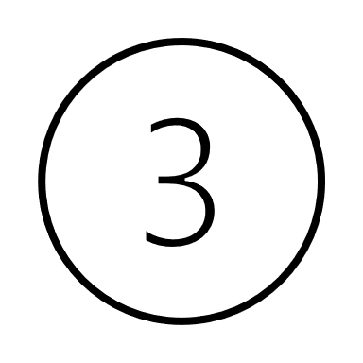
Molecular network and polypharmacy Dataset
Bio decagon dataset
Disease associations
Gene associations

Slide 3
Contents:
Introduction | Brief Introduction about data and relations between fields in it with screenshots of data description file.
Plots | Some types of plots to realize the relations between data.
Find Queries | Some of find queries that applied to the data to retrieve related informations.
Insert Queries | Some of insert queries that applied to the data to insert new fields to the collections of data.
Update Queries | Some of update queries that applied to the data to update old fields with the new data.
Delete Queries | Some of delete queries that applied to the data to delete unimportant data from collections.
Aggregation and Map Reduce Queries | Aggregate and map reduce functions that applied to the data to retrieve important information about it.
Random Queries | The tab that make the user can insert any full query and execute it to see the output.
Indexing | Indexing queries to specific fields entered by user to make the search faster.
Network Graph | Network graph of interacted drugs and its related genes.

Slide 4
01
Introduction

Slide 5



Data description:
large-scale drug combination interaction dataset that contains over 2 million drug combinations and their associated side effects. The dataset is based on the STITCH database, which contains information about the interactions between drugs and proteins.
Relations Based on:
STITCH ID
Polypharmacy Side Effect ID
Gene ID
Files
Source:
SNAP Library (Stanford University).
DisGeNET (Barcelona University).
https://www.disgenet.org/downloads
http://snap.stanford.edu/decagon/

Slide 6
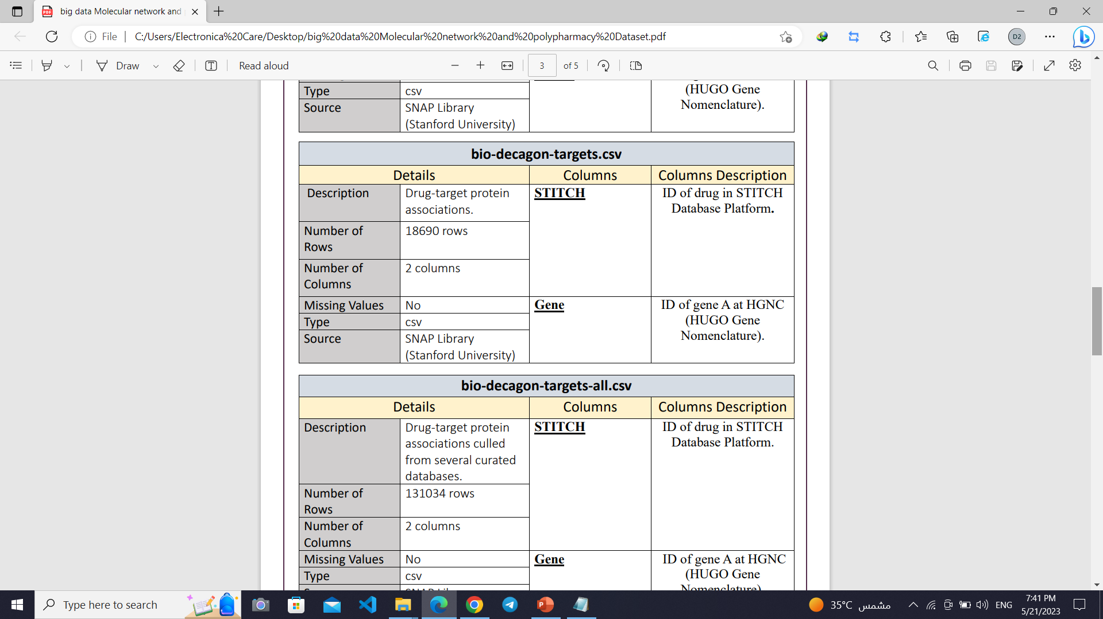
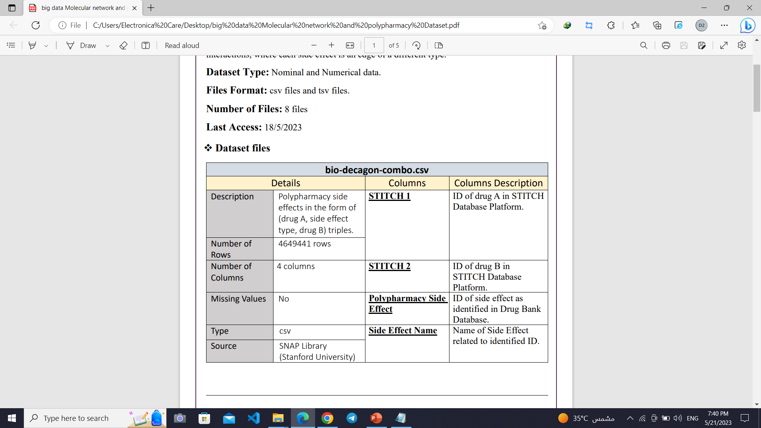
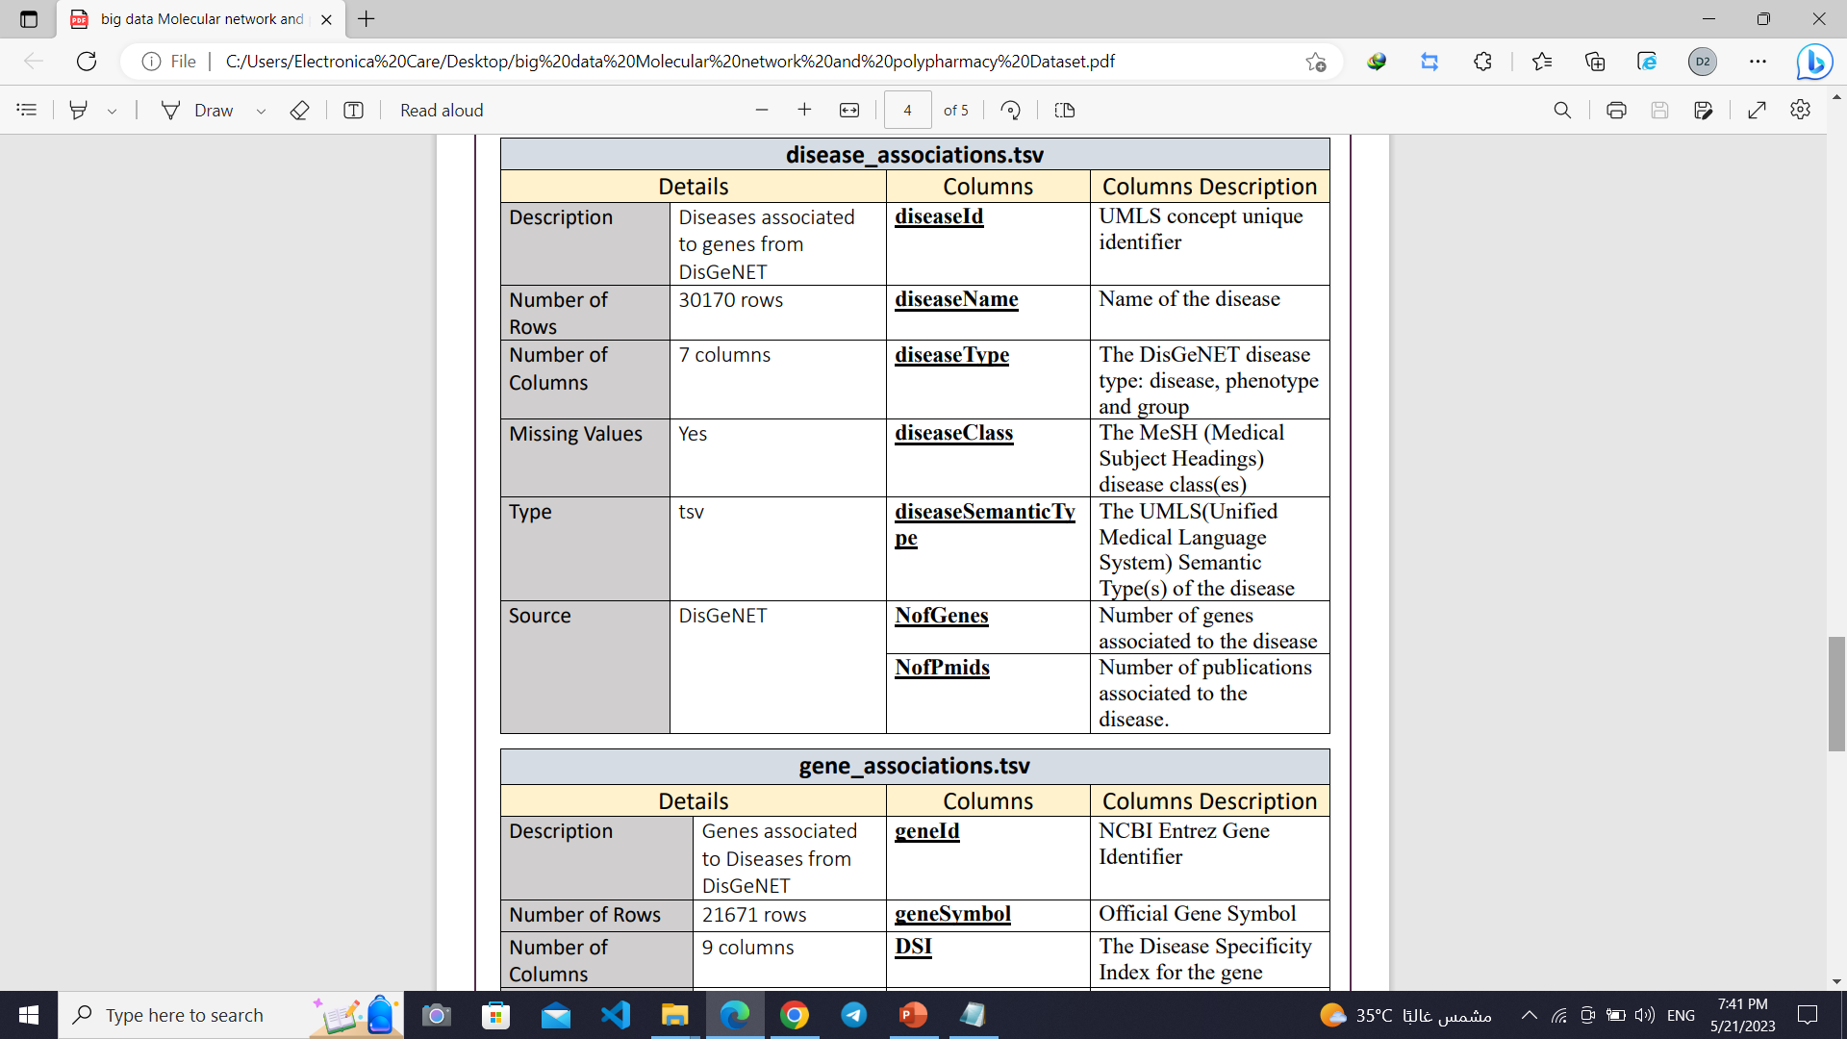

Slide 7
02
Plots

Slide 8
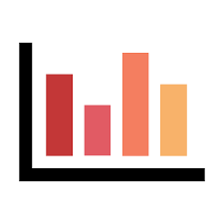
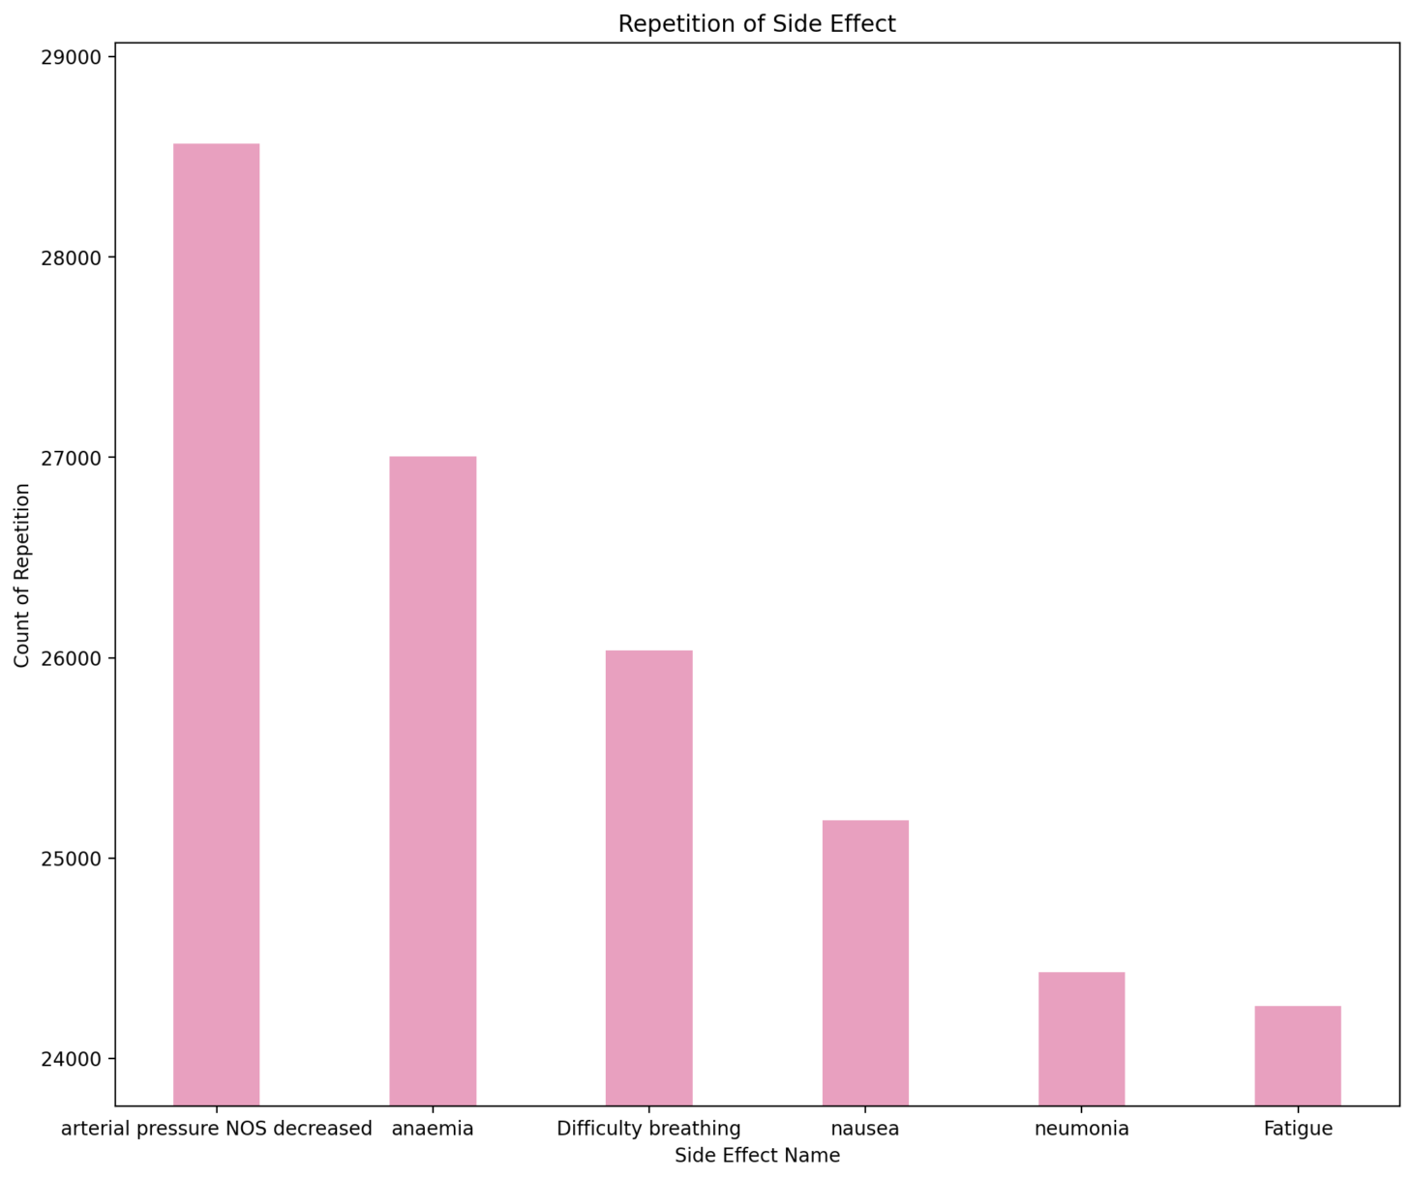
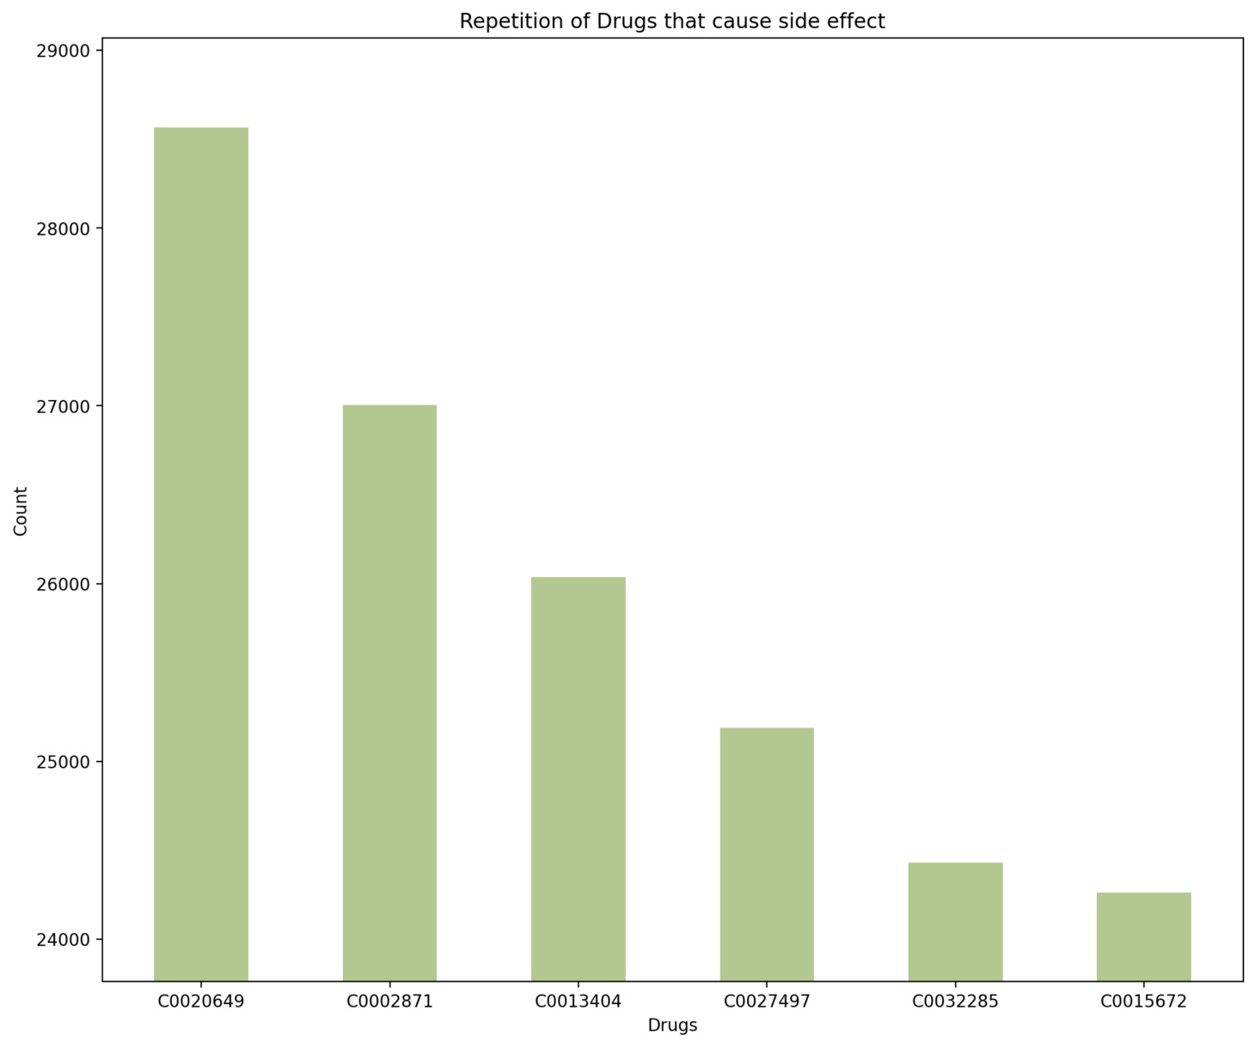
Bar Plots:
Fig1: Illustrated the most repeated side effect names with interacted drugs.
Fig2: Illustrated the most repeated drugs id in STITCH database that caused side effects.

Slide 9
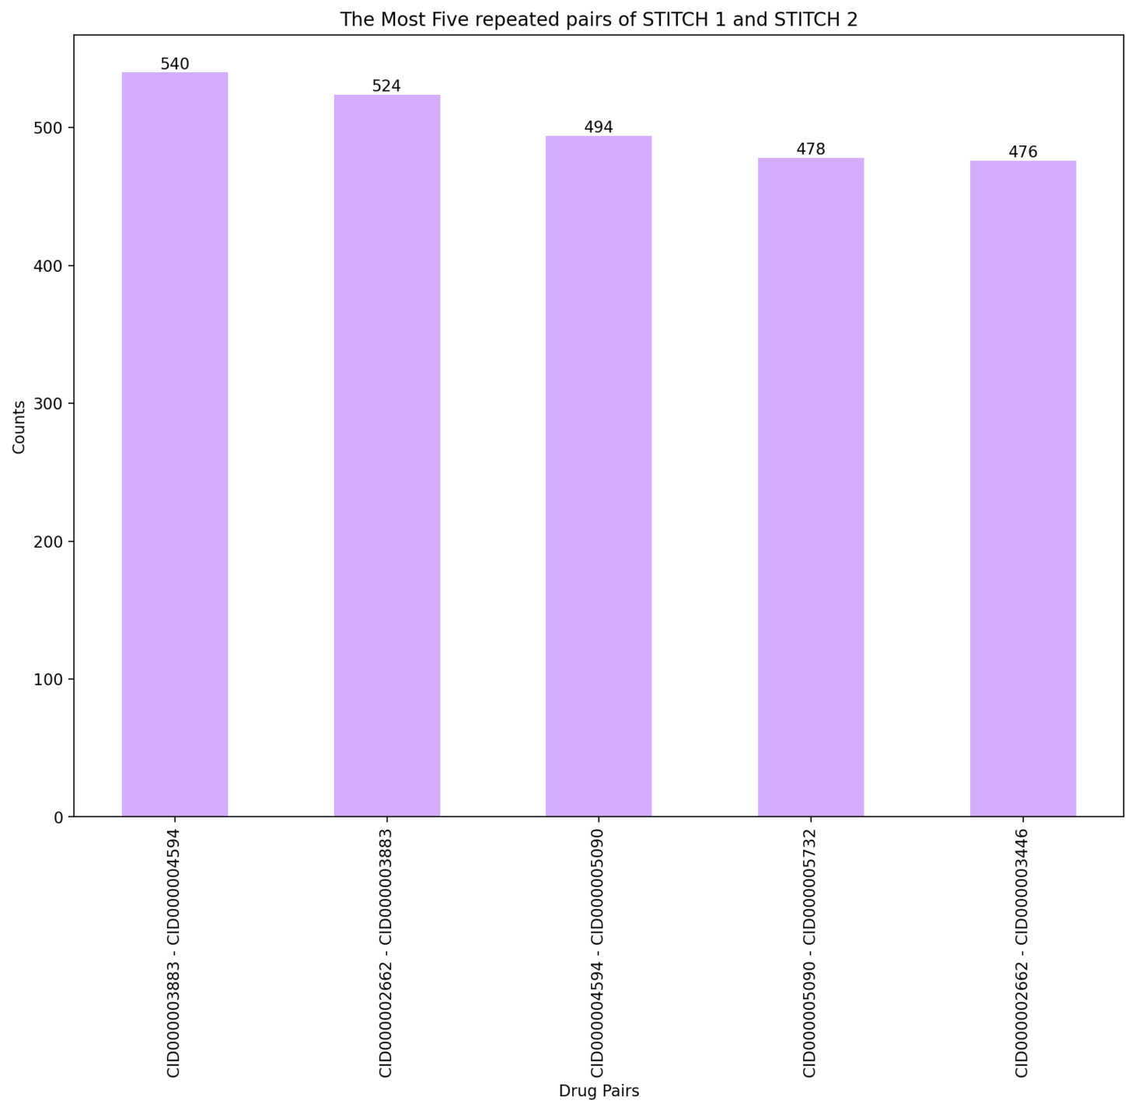
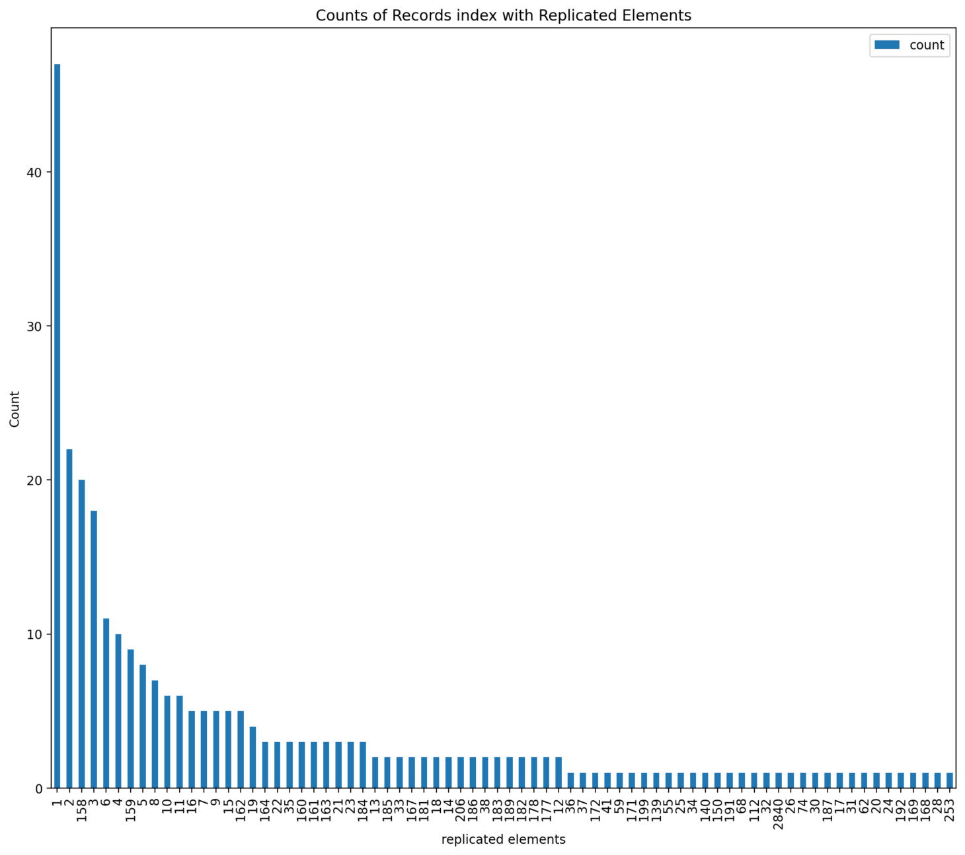
Fig3: Illustrated the most repeated drugs id in STITCH that interacted with each other and caused side effects.
Fig4: Illustrated the number of genes that repeated with drugs id.

Slide 10
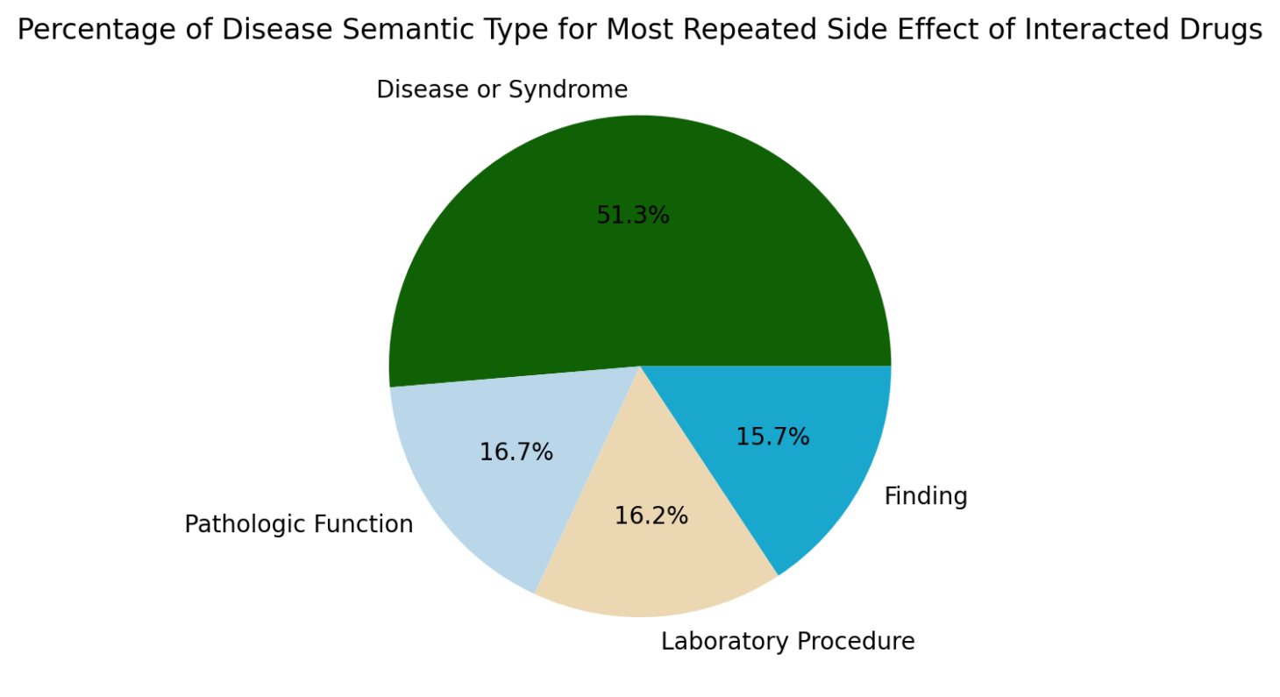
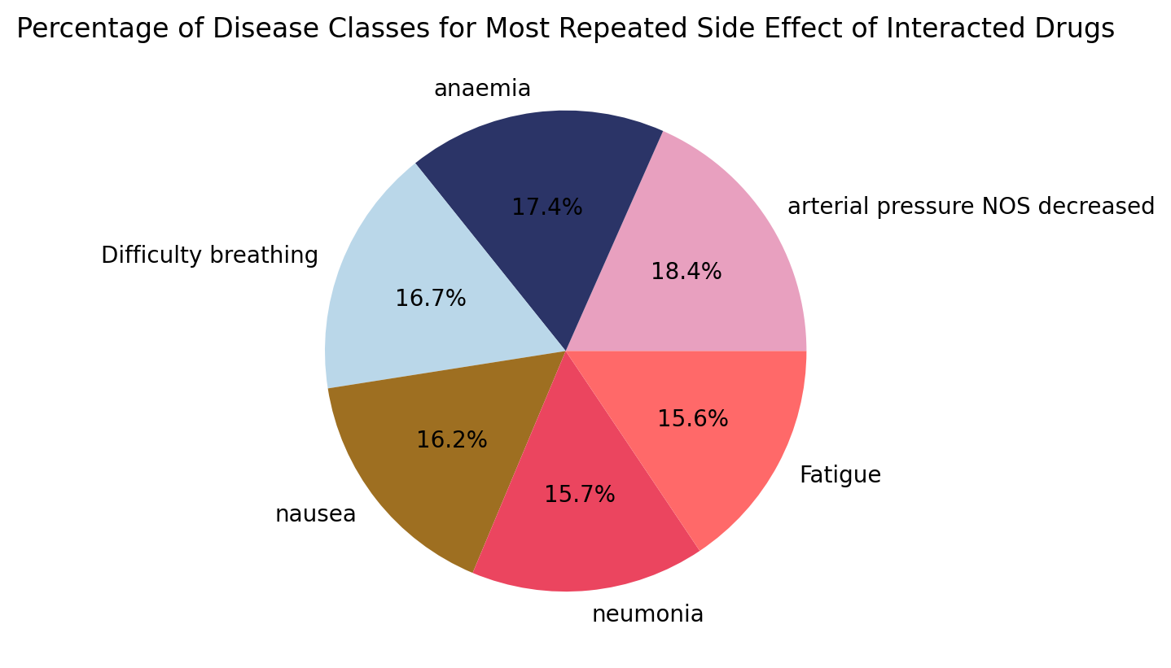
Pie Plots:
Fig5: Illustrated the percentage of disease semantic type for the most repeated drugs id in STITCH that interacted with each other and caused side effects.
Fig6: Illustrated the percentage of the most repeated side effect names with interacted drugs.

Slide 11
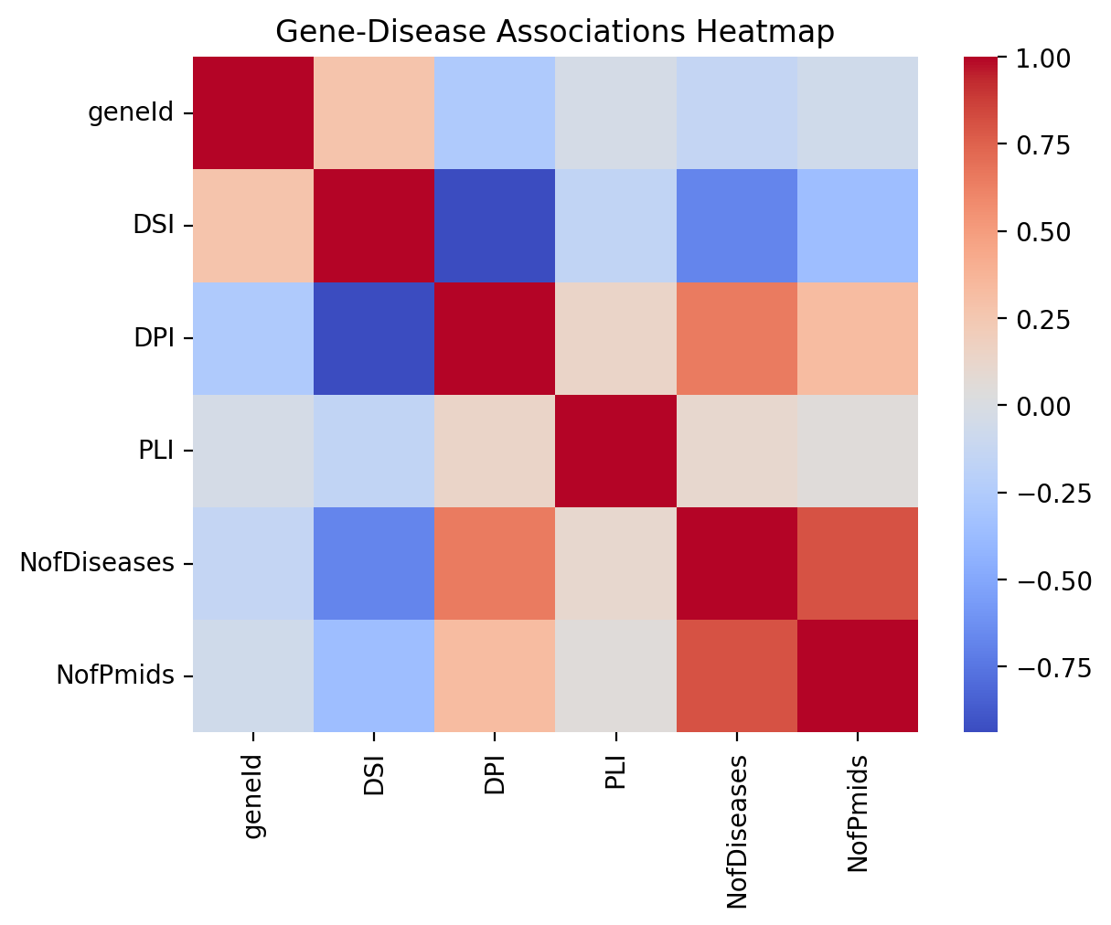
Heatmap:
Fig7: Illustrated the correlations between the genes’ data that related to side effects ,As red indicating a positive correlation and blue indicating a negative correlation.

Slide 12

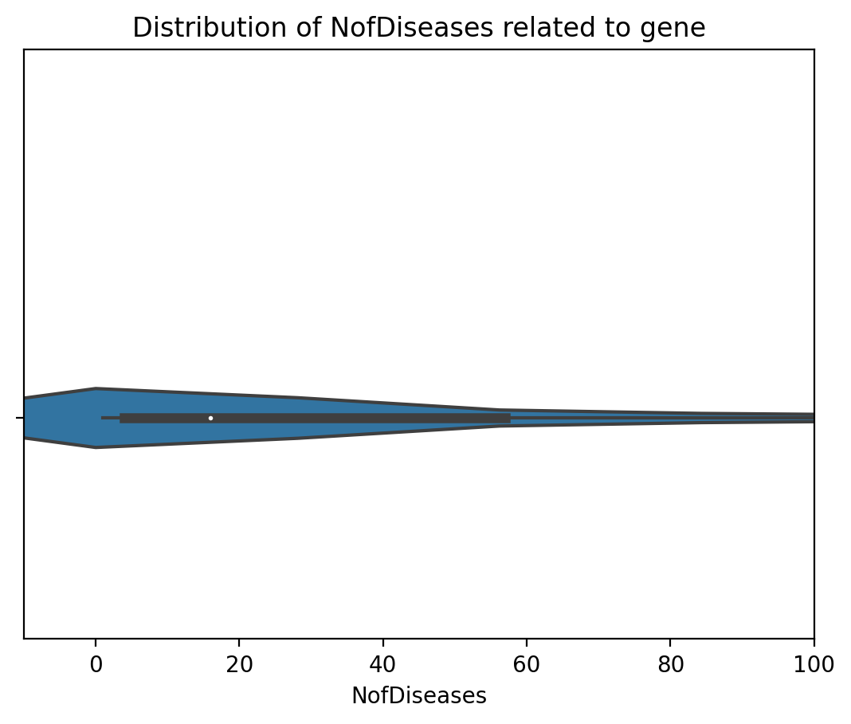
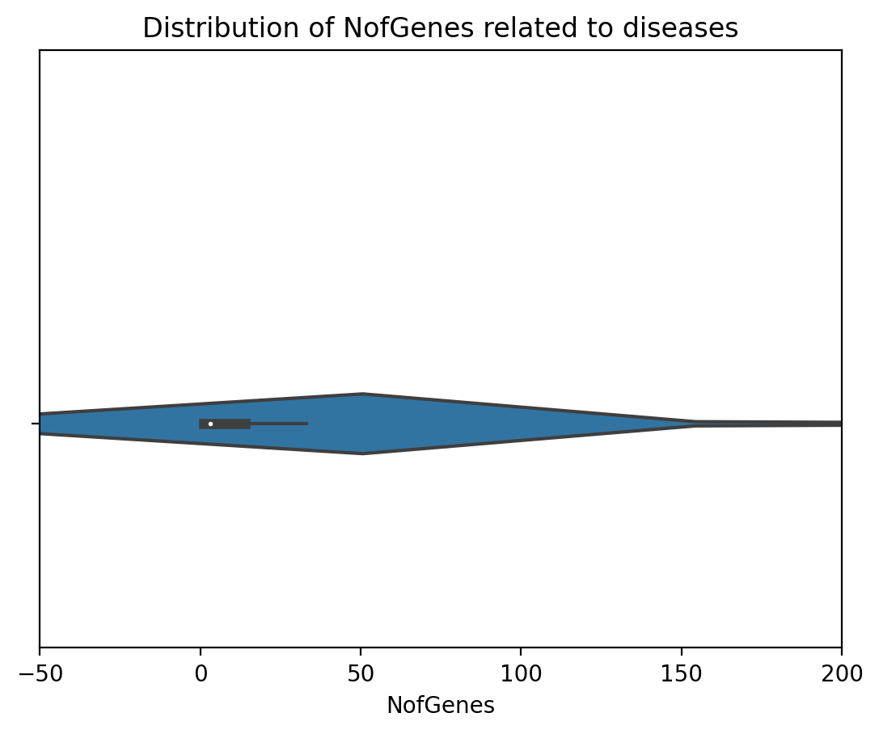
Violin Plots:
Fig8: Illustrated the density distribution of numbers of diseases that related to each gene.
Fig9: Illustrated the density distribution of numbers of gene that related to each disease.

Slide 13

03
Find Queries

Slide 14
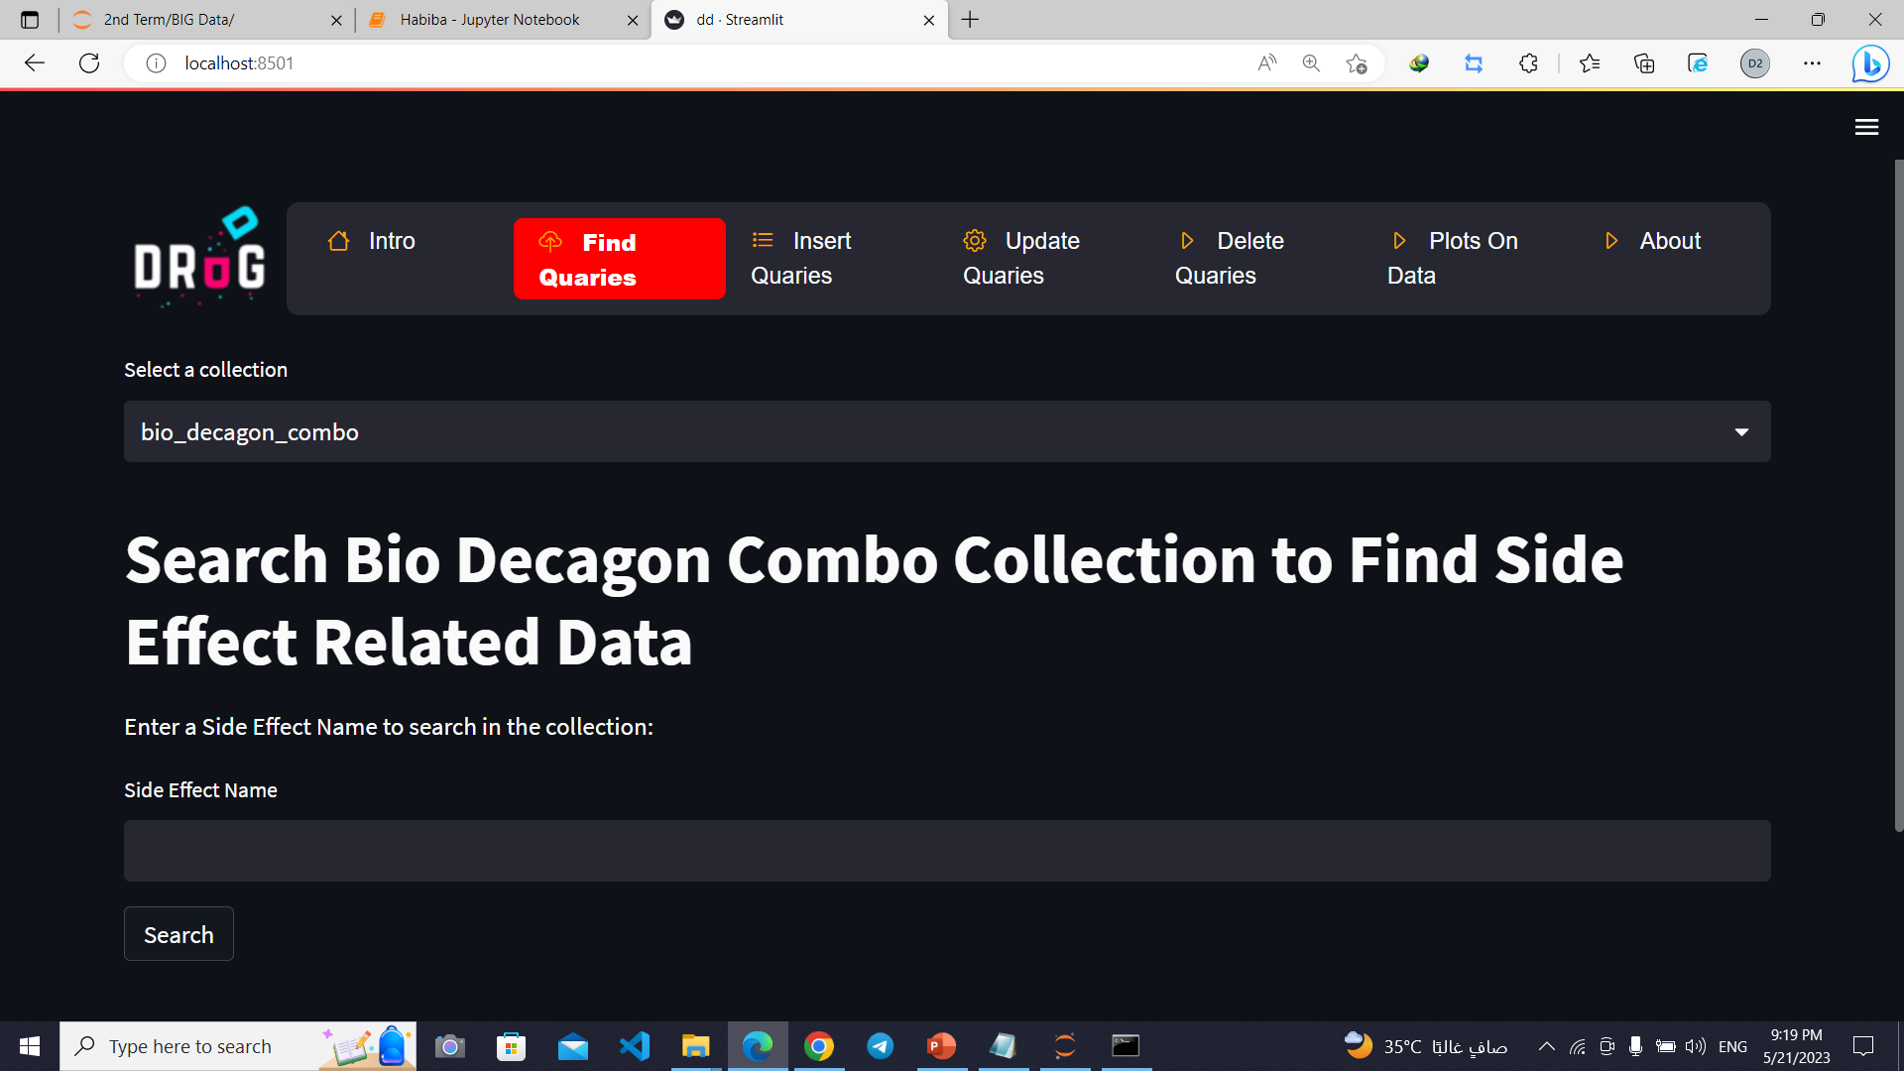
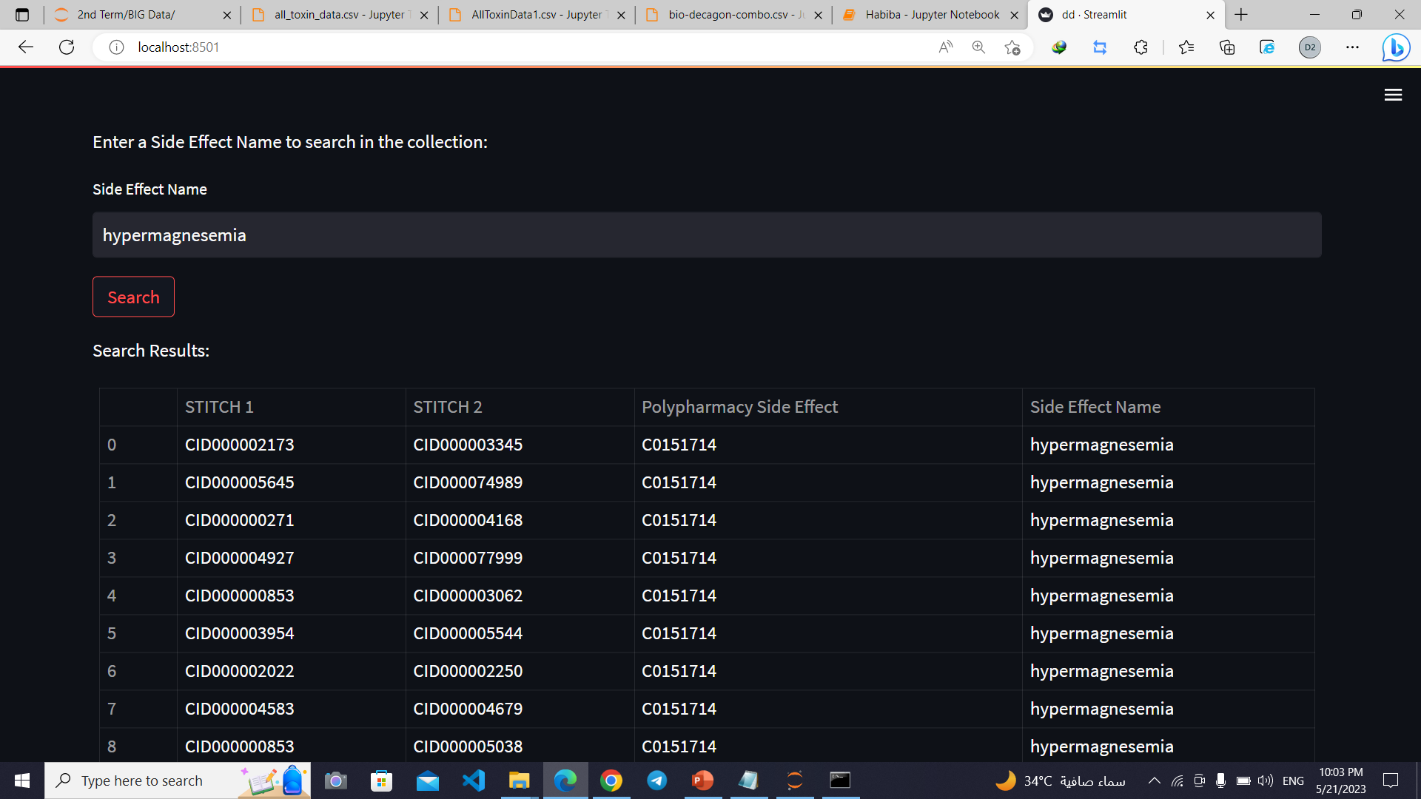
Search: hypermagnesemia

Slide 15
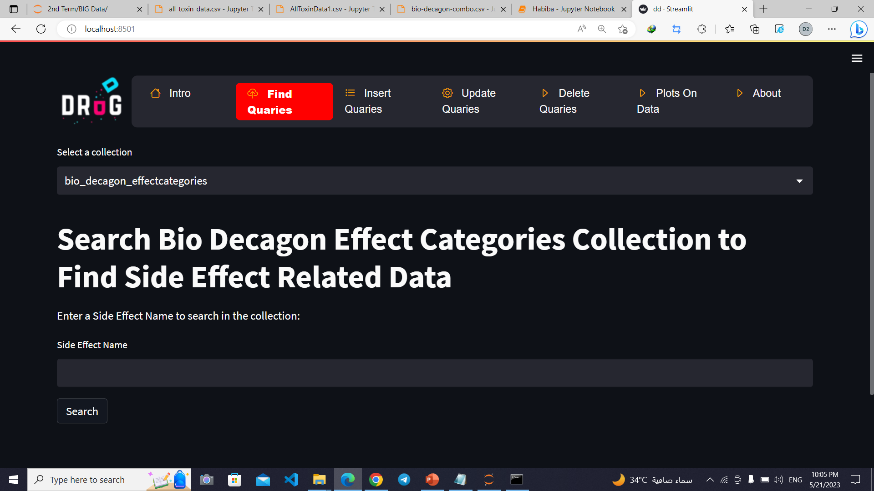
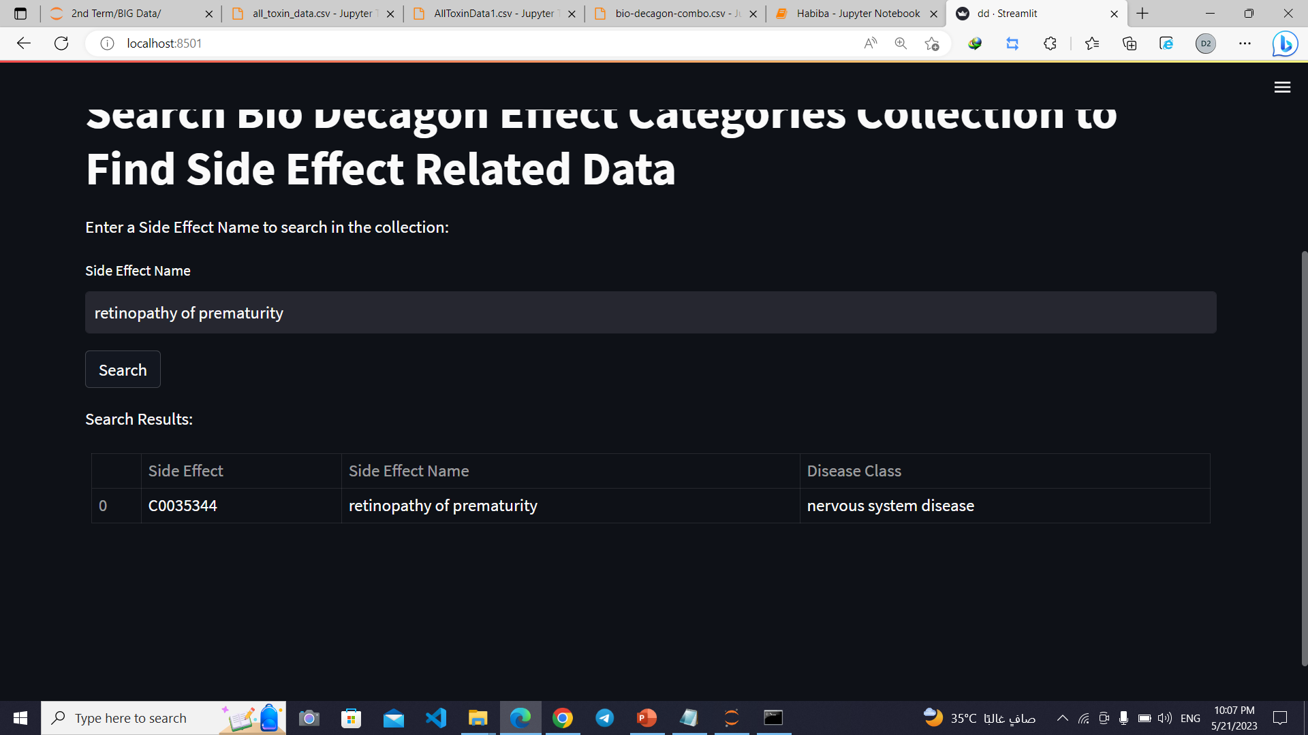
Search: retinopathy of prematurity

Slide 16

04
Insert Queries

Slide 17
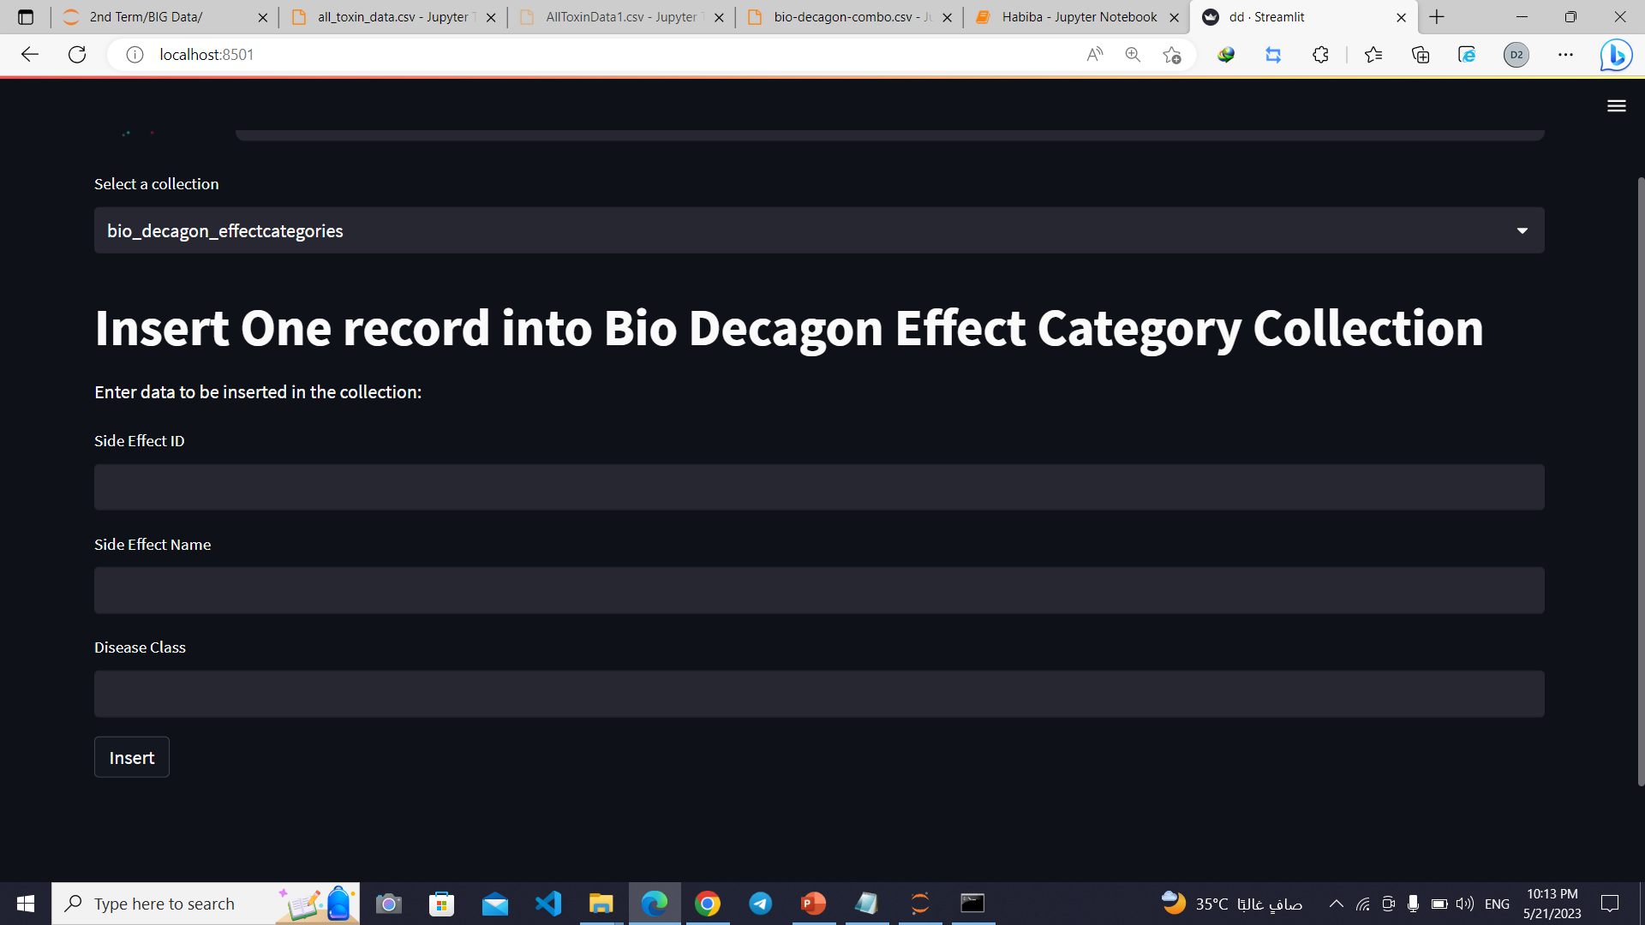
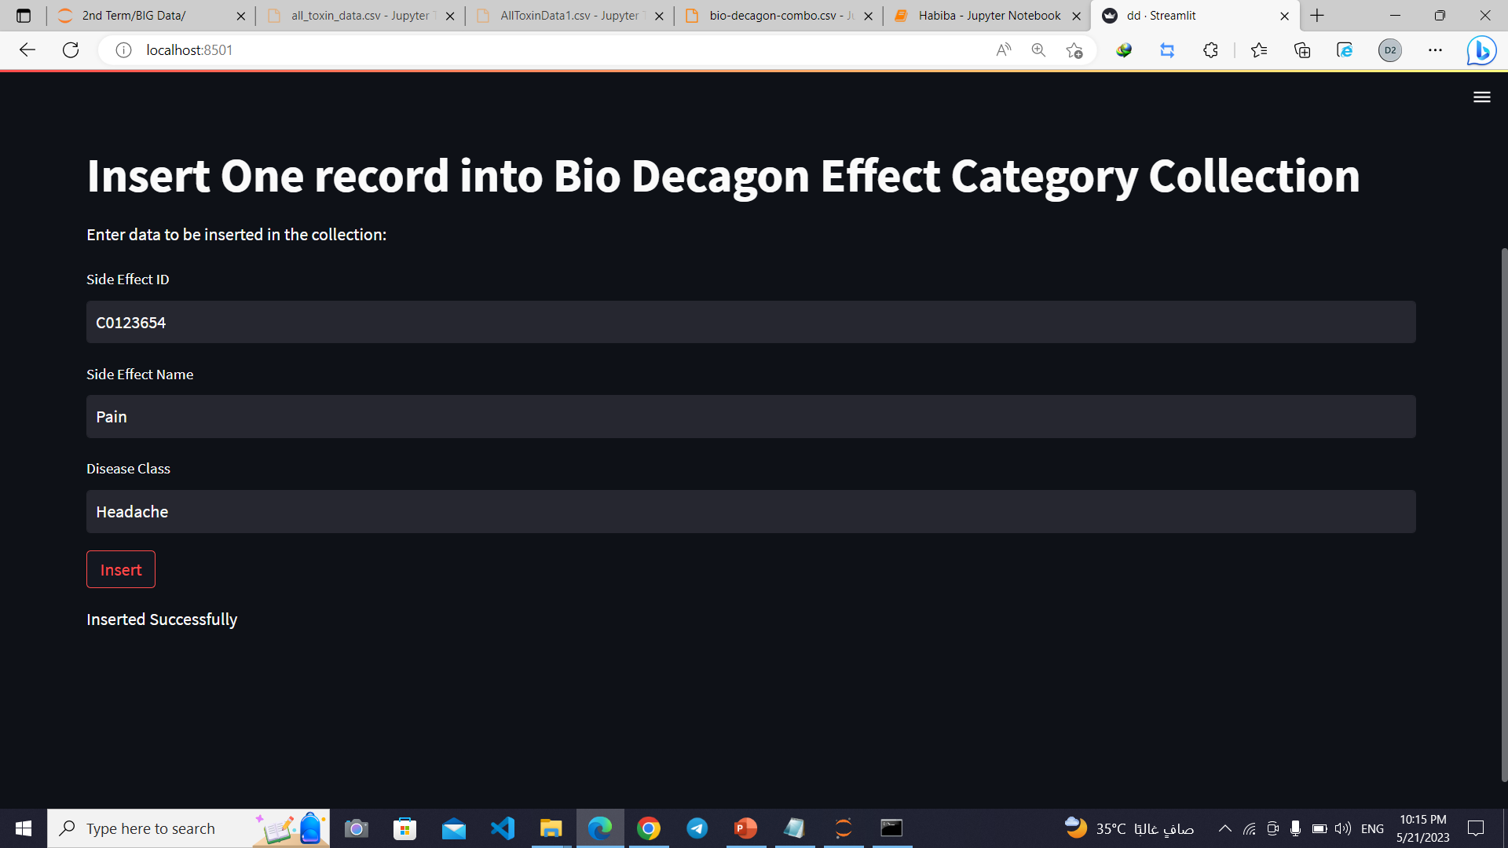
Insert Data

Slide 18
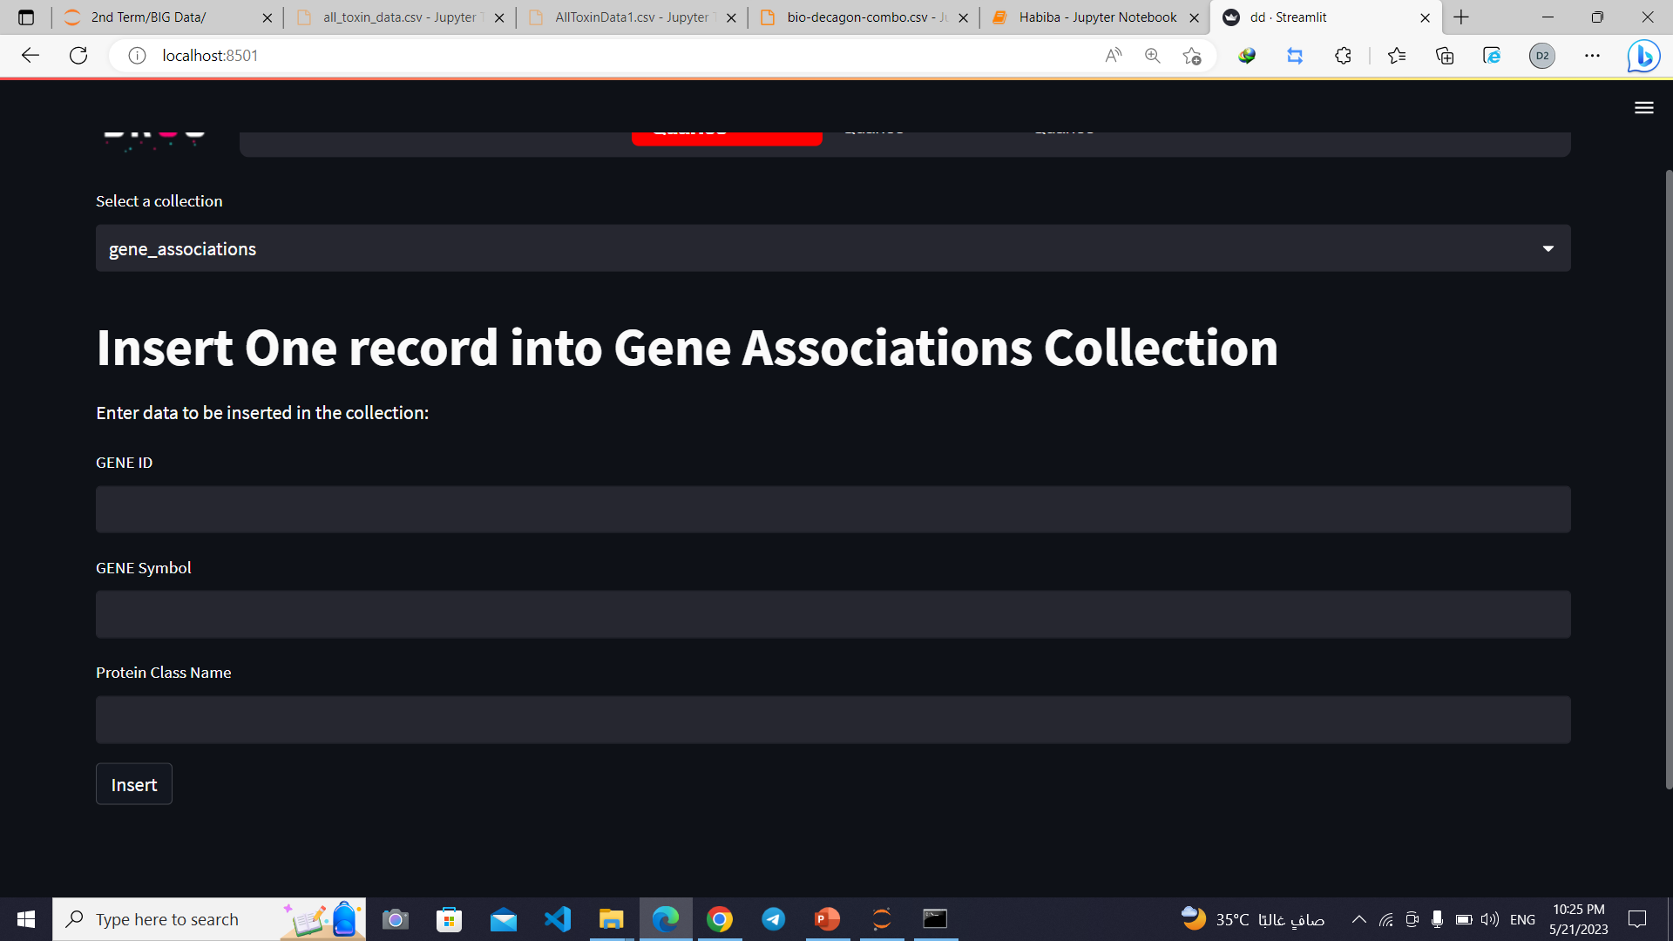
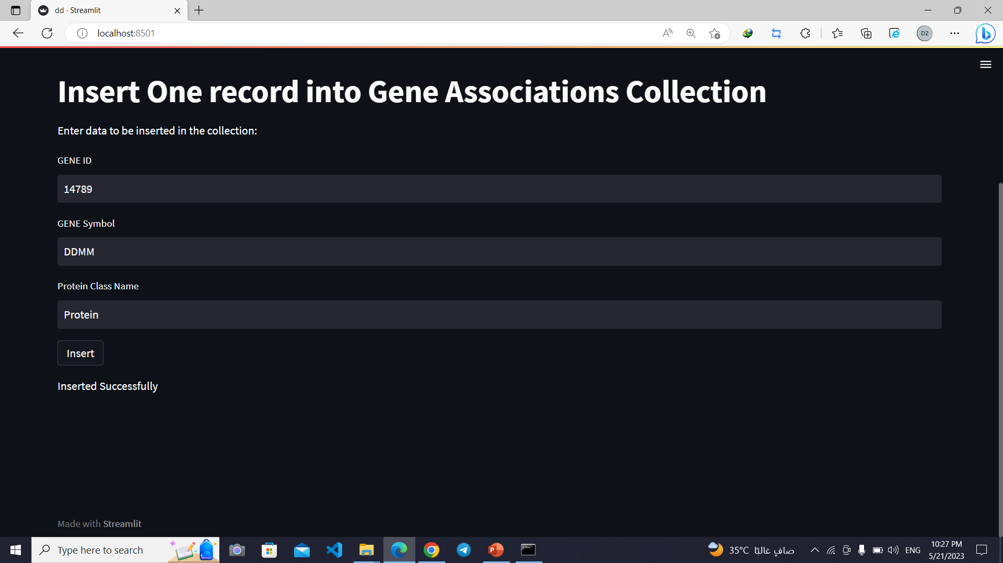
Insert Data

Slide 19

05
Update Queries

Slide 20
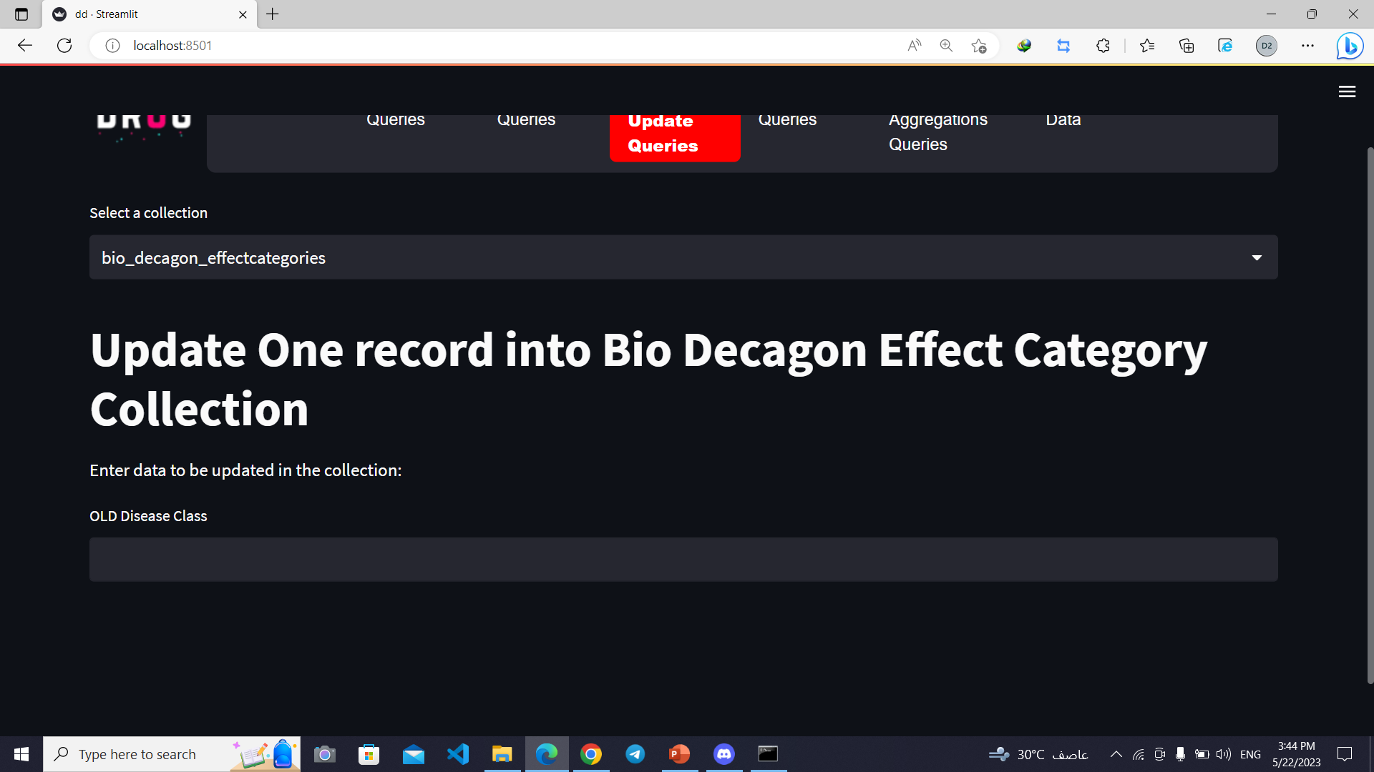
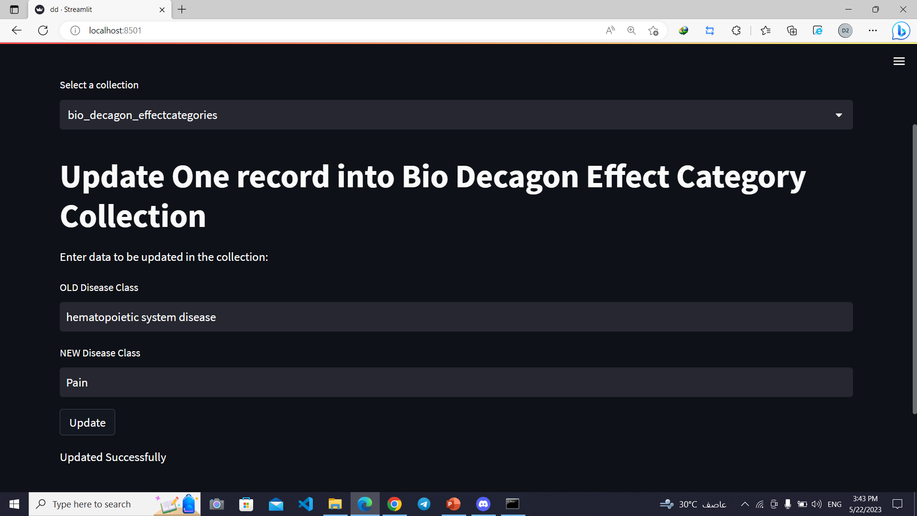
Updated Data

Slide 21
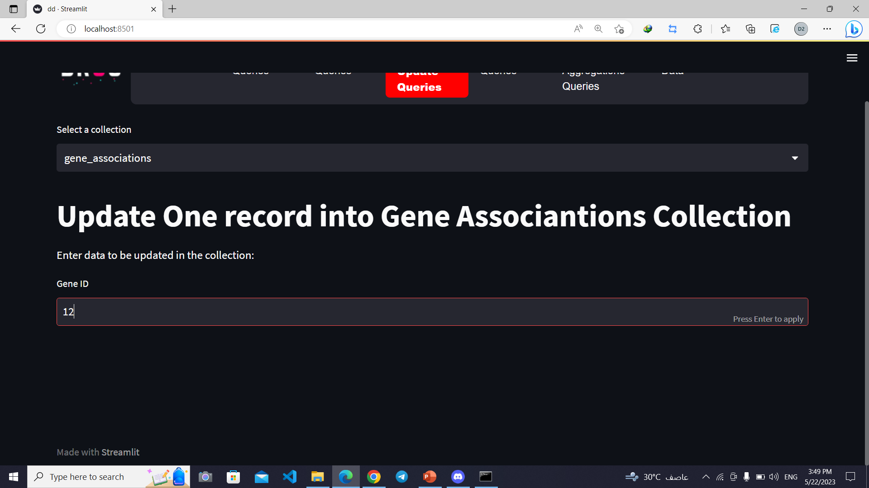
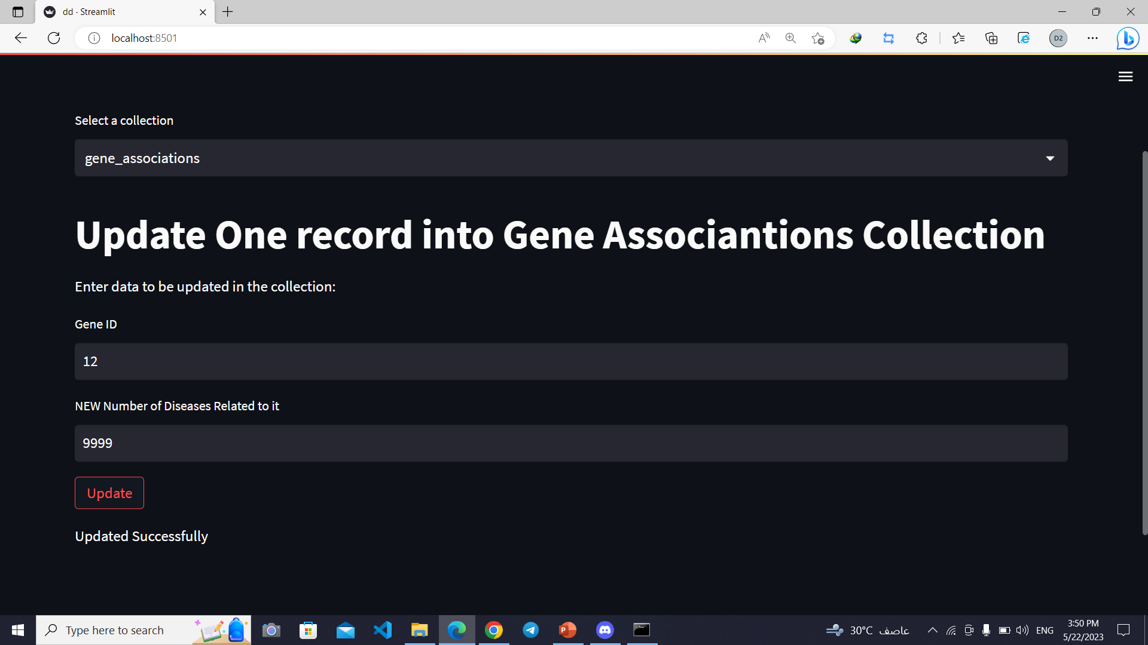
Updated Data

Slide 22

06
Delete Queries

Slide 23
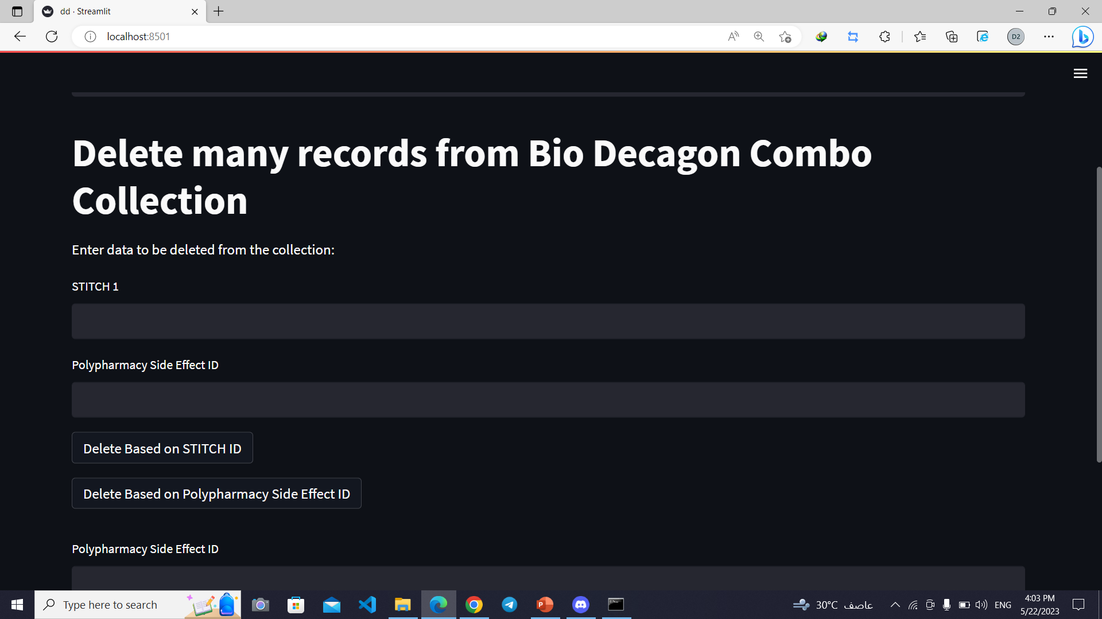
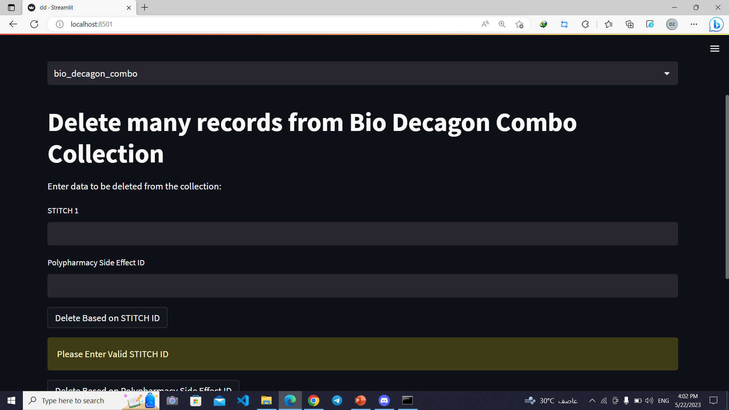
Empty Data

Slide 24
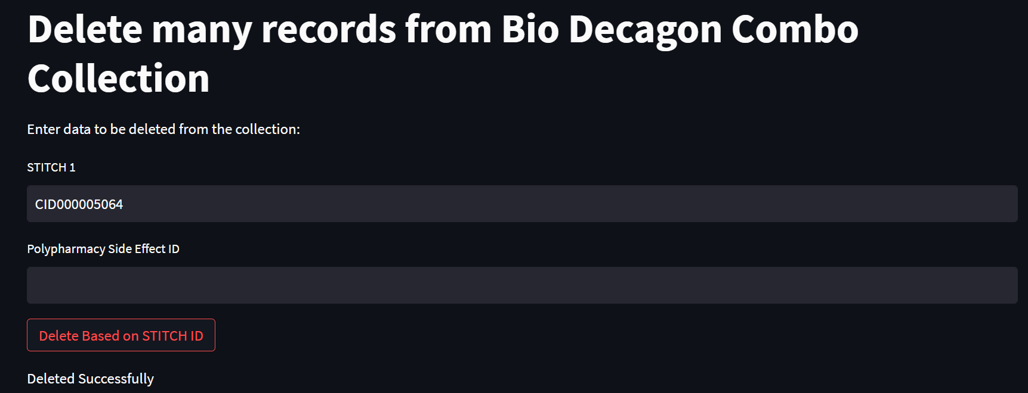
Existed Data based on STITCH ID

Slide 25

07
Aggregation Queries

Slide 26
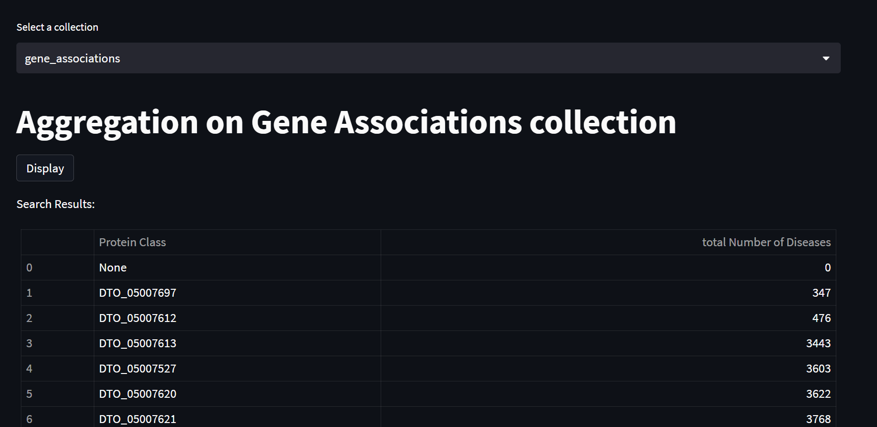
Map Reduce using Aggregation

Slide 27
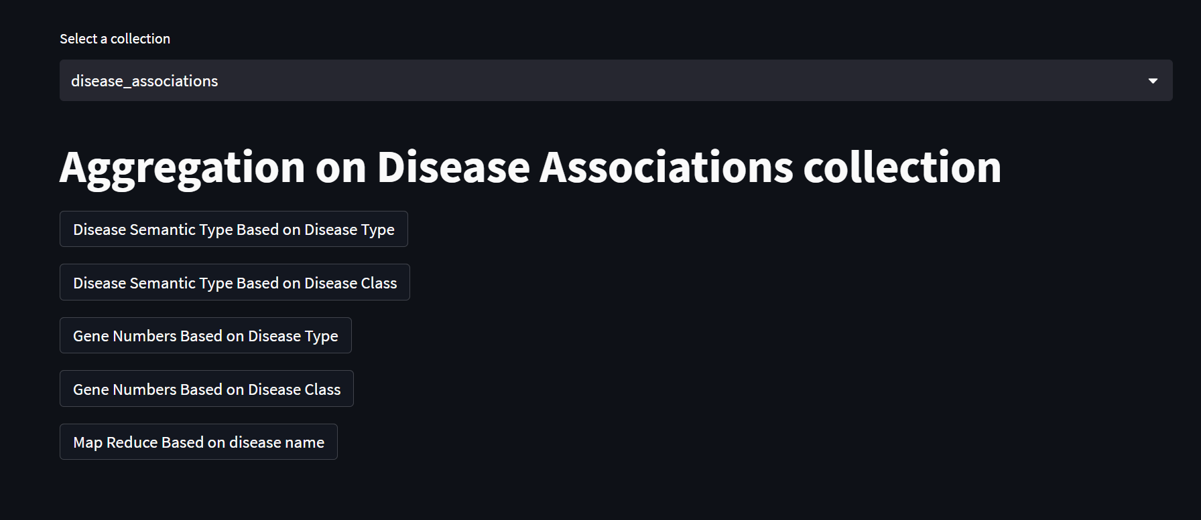

Slide 28
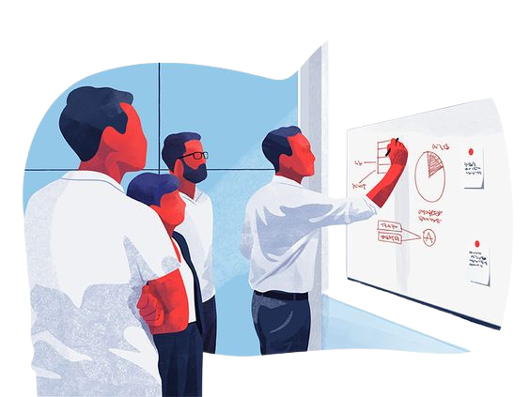
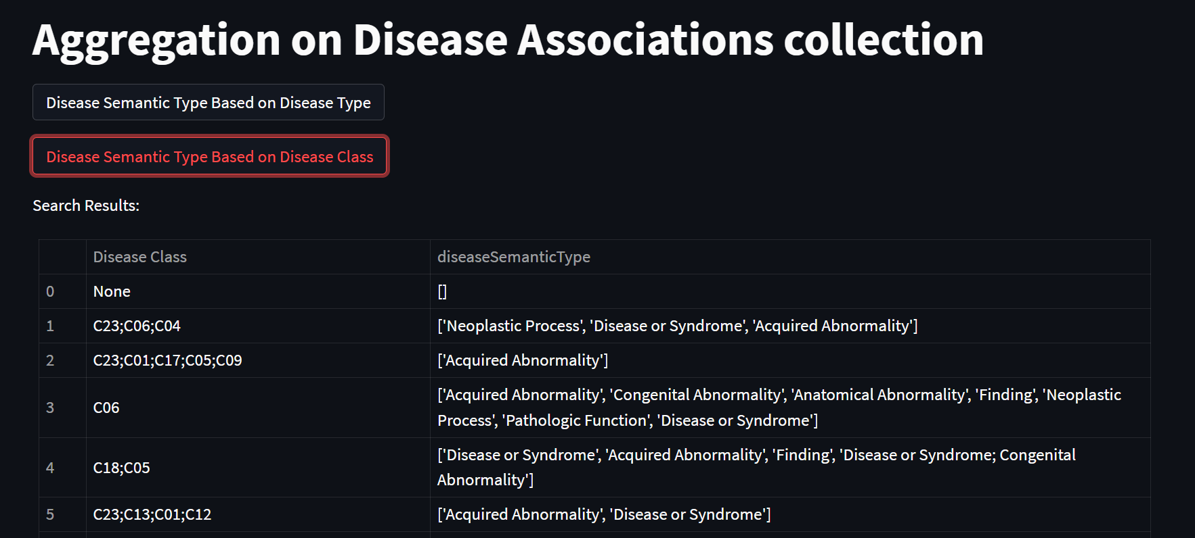

Slide 29

08
Random Queries

Slide 30
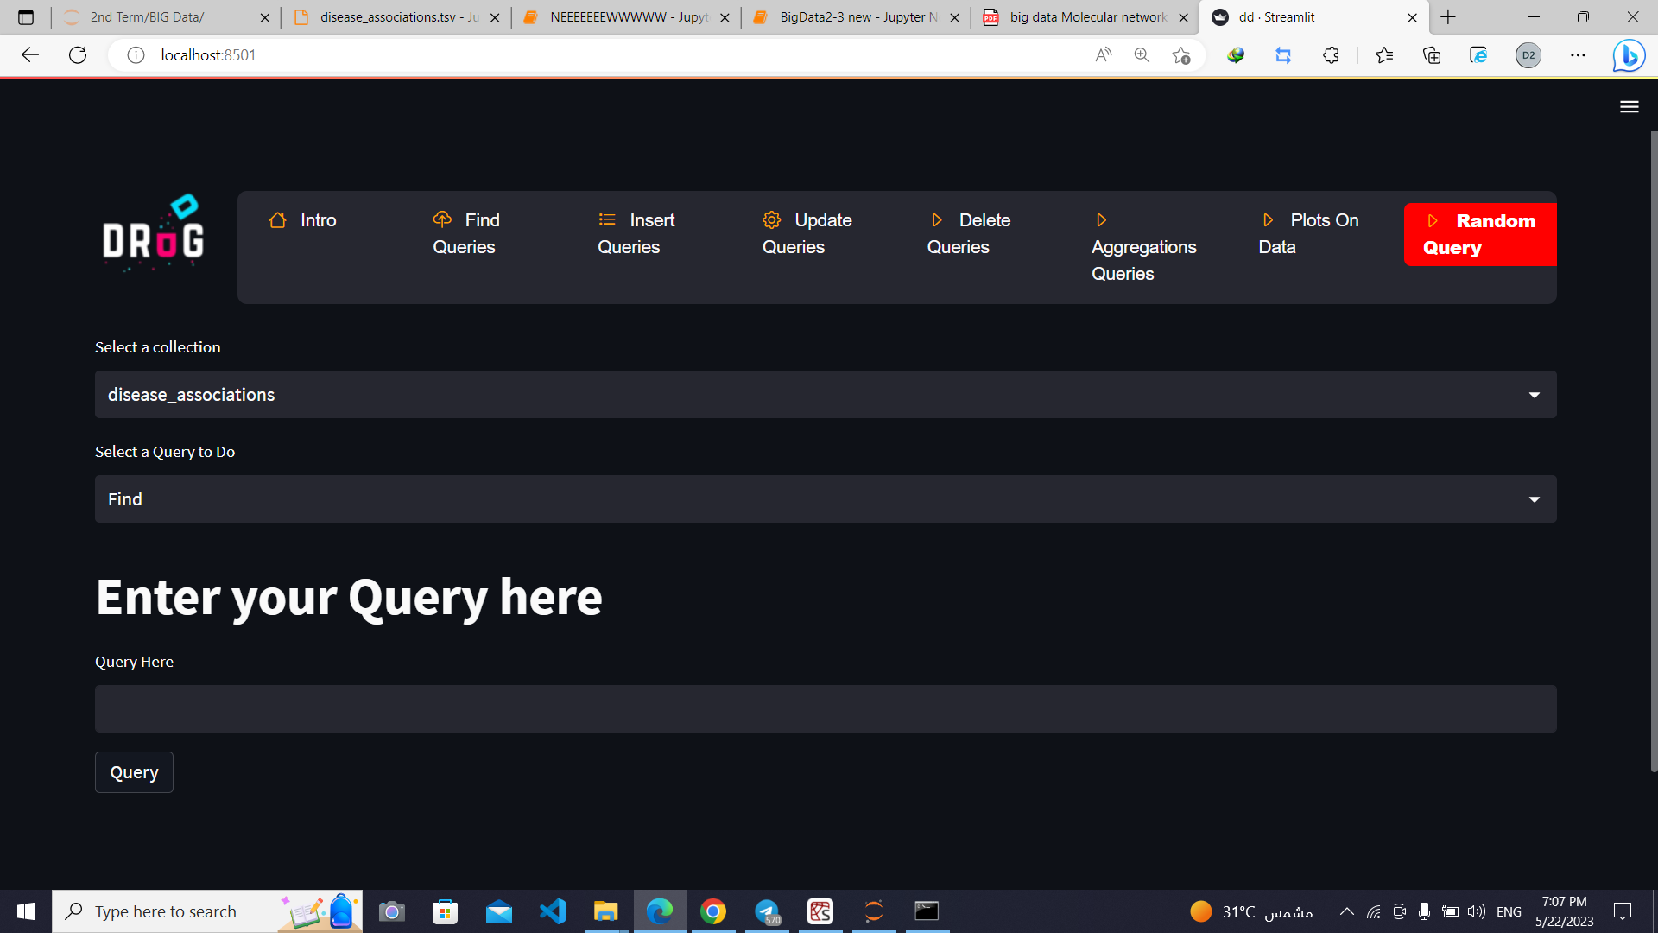
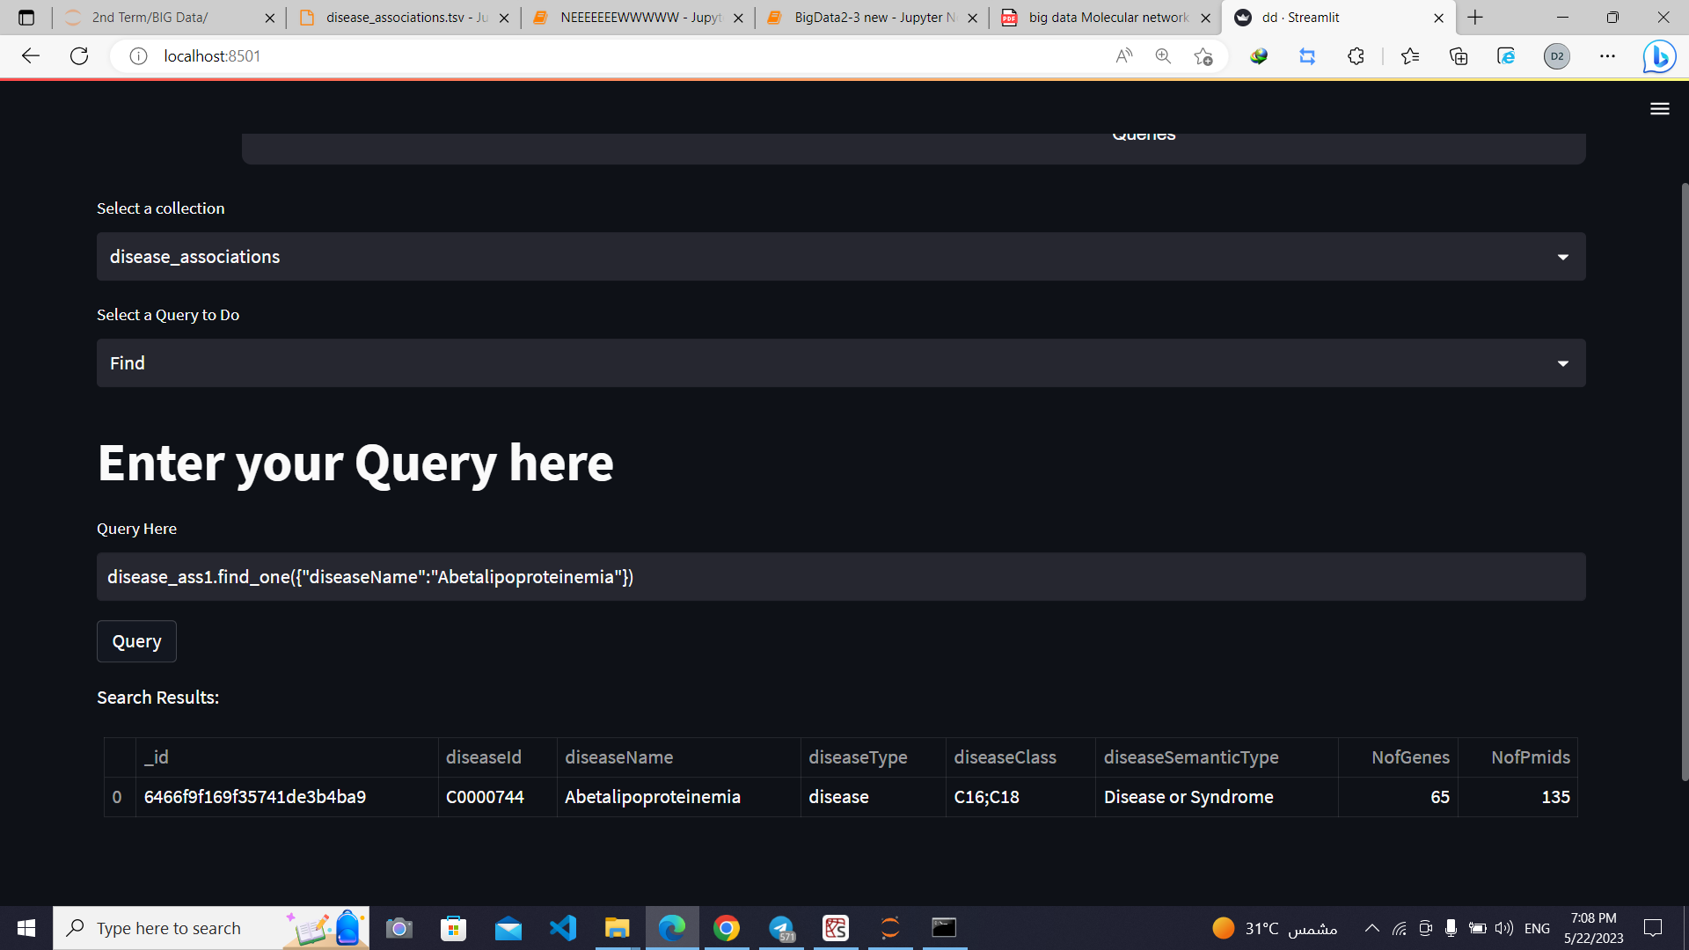
Entered query

Slide 31

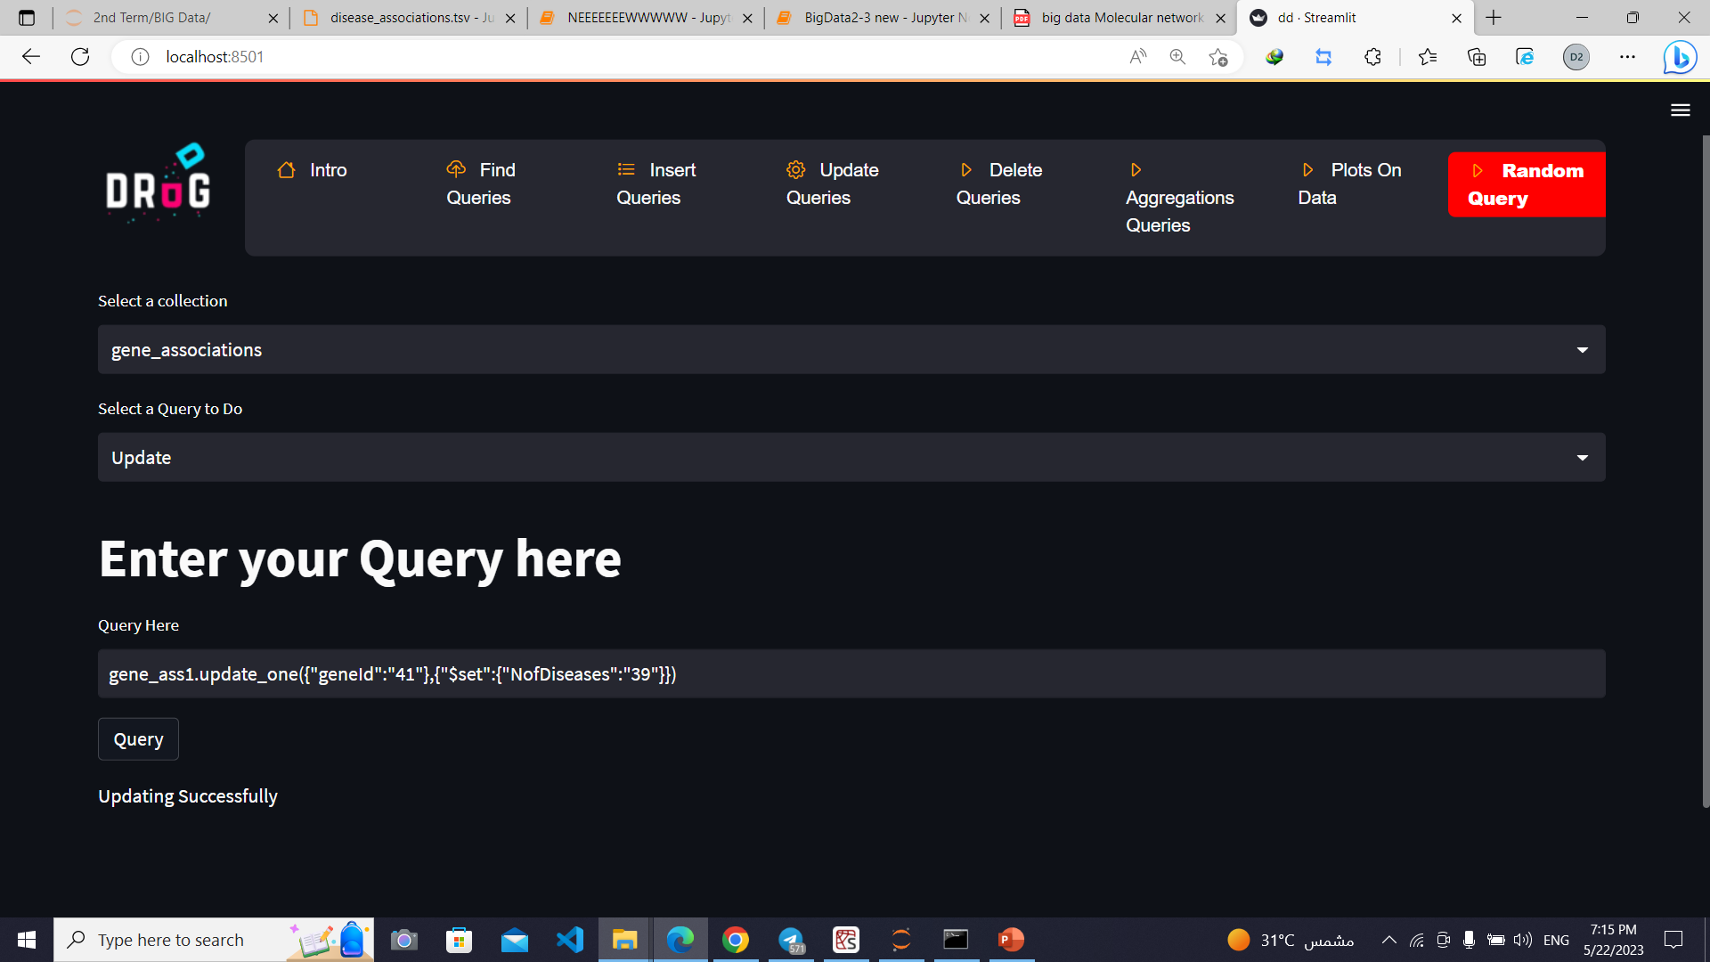
Entered query

Slide 32

09
Indexing

Slide 33
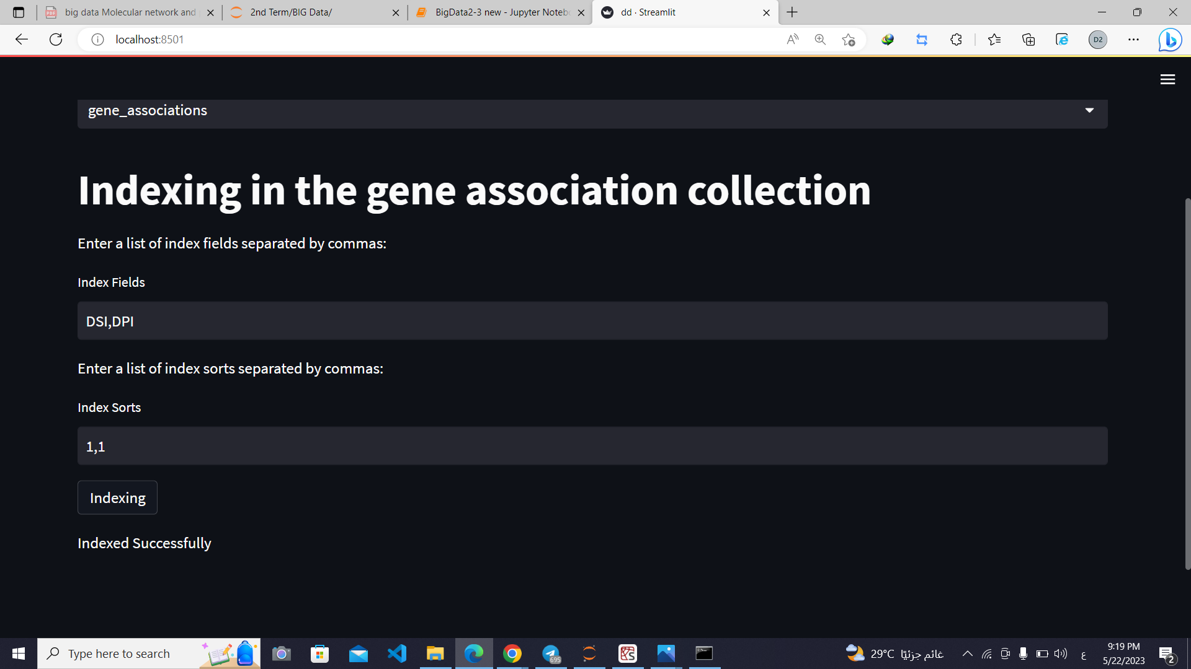

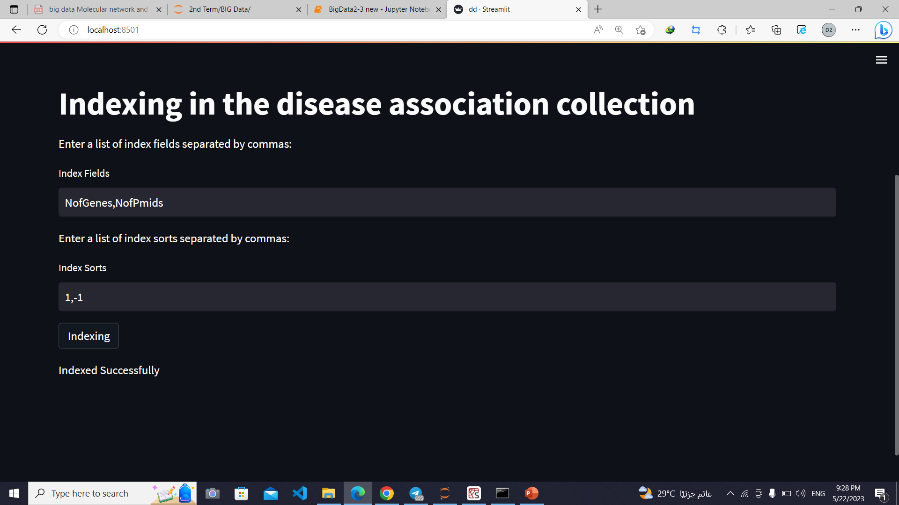


Slide 34
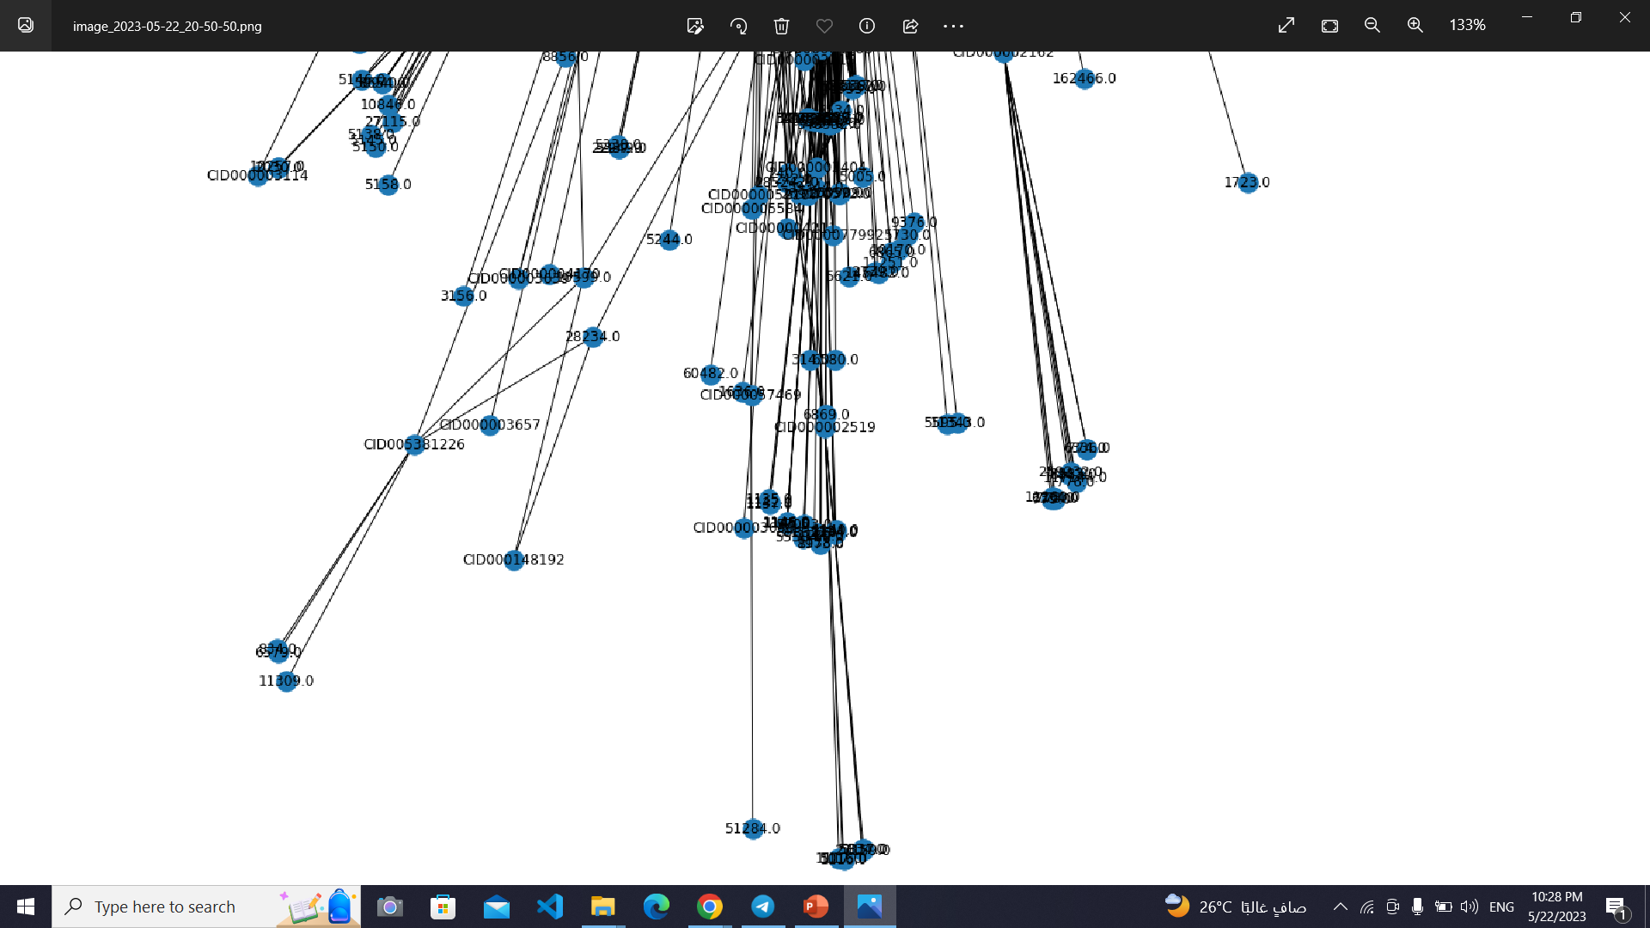
Network Graph
Network graph of Bio decagon target dataset:
Node: STITCH ID , GeneID
Figure illustrates zoomed in view of network graph.

Slide 35

Thanks

